Slide 1
European External Investment Plan
12th Eastern Partnership – Transport Panel
Tuesday, March 14, 2017

Slide 2
EC Communication on establishing a new Partnership Framework with third countries under the European Agenda on Migration (June 7th 2016)
The European Commission:
calls for a long term strategy by which the EU will promote the sustainable development goals and thus address root causes of migration and…
…proposes a full range of innovative financing mechanisms that will be able to:
Leverage loan and grant financing
Encourage public-private partnerships and
Crowd-in private investment.

Slide 3
The External Investment Plan Chronological Data
28 June 2016: The EU Council invited the Commission to present a proposal for an EIP
14 September 2016: Commission Proposal on the EIP and legislative proposal on the European Fund for Sustainable Development (plus revision of the ELM plus EFSI 2.0)
15 December 2016: EU Council informal position achieved
February – April 2017 - Parliament Discussion
Trilogue (EP-Council-Commission) right after
Final Adoption - expected by the Summer 2017

Slide 4
Global economic crisis
Low economic growth
Low level of private investment
Increased migratory flows
Political Instability
Africa and Neighbourhood
4

Slide 5
The European External Investment Plan (EIP)
Sustainable Development Goals
AAAA / ENP *
EIP
Investments required to achieve the Sustainable Development Goals range from US$ 1.6 to 2.8 trillion annually (UN calculation)
Private sector investments key for sustainable development and job creation, thus tackling root causes of migration.
* Addis Ababa Action Agenda / European Neighbourhood Policy
5

Slide 6
Mobilise investments for economic development, through
Pillar 1
Pillar 2
Pillar 3
Support
Support
Development Finance
Regional Investment Platforms (EU Neighbourhood and Africa)
NEW EU guarantee
Enhanced technical
Assistance
(1) To help developing bankable projects which could be financed under pillar 1
(2) To support activities aimed at enhancing business climate under pillar 3
More dynamic business environment
Political and policy dialogue for economic reforms
Support legal, institutional and regulatory frameworks
Engaging with the private sector
One-Stop-Shop/Web Portal
6

Slide 7
Pillar 1: The European Fund for Sustainable Development (EFSD)
Blending Platforms (Neighbourhood Investment Platform and Africa Investment Platform)
EFSD Guarantee

Slide 8
EFSD Governance
Strategic board
Members: Commission, EEAS, EU Member States, EIB
Observers: IFIs, partner countries, European Parliament
Operational boards
Commission, EEAS & EU Member States
Africa
Neighbourhood
Secretariat
Commission Services
G-TAG
8

Slide 9
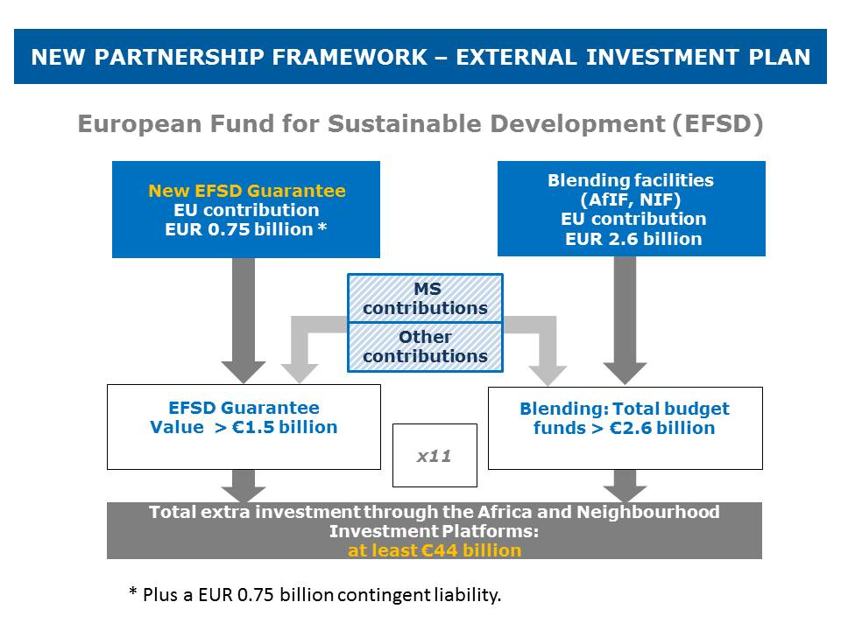
Sources of financing (Pillar I)
9

Slide 10
Blending Platforms: From NIF to NIP
The next NIP strategic orientations meeting will be held in 2017 to further refine strategic priorities and outlook.
The NIP's strategic orientations for the Eastern Neighbourhood are expected to reflect the Riga Priorities:
Sustainable and inclusive growth
Job creation
Climate change and environment
In line with objectives of the revised EU Neighbourhood Policy
EU thematic, regional and country-level development cooperation – Riga Priorities for EaP Countries

Slide 11
The EFSD Guarantee
A powerful risk mitigation mechanism to stimulate investments in Africa and the Neighbourhood.
A guarantee capacity for credit enhancement - will ultimately benefit the final investments and allow risk sharing with other investors, notably private actors.
Will leverage additional financing, in particular from the private sector (crowding in), by reducing the risk associated with specific operations.
Will provide liquidity from its guarantee fund (liquidity cushion)

Slide 12
Flow Chart 1 – Setting-up an Investment Window
Possible inputs by:
Strategic Board of the EFSD
Strategic Guidelines
Political guidance
Partner Countries
EFSD Secretariat
Proposal
IFIs and EDFIs
Private sector
Operational Board of the NIP
Adoption of Investment Window guidelines
Civil Society
Int. Org.
Decision by the Commission
Investment Window established
Investment Window guidelines published

Slide 13
Flow Chart 2 – Application process and evaluation
Inv. Window
IFI Proposal
EDFI Proposal
Priv. Sect. Proposal
1. Drafting Proposed Investments Programs
2. Submission of proposals
EFSD Secretariat – One Stop Shop
Pre-screening
G-TAG
Financial Assessment
3. Assessment
Operational Board of the NIP
Opinion
Decision by the Commission
4. Signature of Guarantee Agreements
COM – IFI
Guar. Agr.
COM – EDFI
Guar. Agr.
COM – PS.
Guar. Agr.
Other (mainly private) investors
Final Beneficiaries
Final Beneficiaries
Final Beneficiaries
Final Beneficiaries
Final Beneficiaries
Final Beneficiaries

Slide 14
What type of projects and risks could be addressed?
PPPs
PPPs are undoubtedly a key way of harnessing the private sector, but limited bankability remains a recurring theme.
With PPPs, bankability could be enhanced through a guarantee. This could be used to lower project risk and so serve as credit enhancement thus encouraging private sector lenders to finance the project.
This could first take the form of guaranteeing any termination payment (frequently identified as a key element of risk by the private sector) which is payable if the municipality or State fails to meet its obligations under the PPP contract.
Second, it could cover potential lack of liquidity of the municipality or State to make short term payments because of other commitments and thus avoid early termination of the PPP contract.

Slide 15
Pillar 2: Technical Assistance Main elements

Slide 16
Technical Assistance
TA will still be provided in the context of the investment platforms under pillar 1, for preparation and implementation of bankable projects
Support to developing effective institutions and legal frameworks, with the objective of improving the investment climate
Support to public-private dialogue, involving business fora, investment/export promotion agencies

Slide 17
Pillar 3: Policy dialogue to improve economic policies, the investment climate and engagement with the private sector Main elements

Slide 18
Pillar 3: Economic Policies, Investment Climate, Private Sector
Improving the investment climate through enhanced policy dialogue with Partner countries, identify key structural reforms and support priority investments through the EFSD.
This includes:
Supporting economic transformation and development in partner countries: institution building, macroeconomic framework, structural economic reforms.
Improving the business environment: regulatory framework, workforce availability and skill level, access to finance, access to innovation etc.

Slide 19
Pillar 3: Economic Policies, Investment Climate, Private Sector
Leverage the EIP financial instruments to step up policy dialogue on economic policies and structural reforms
Involve local stakeholders, in particular the private sector to achieve the EIP objectives
Ensure coordination with other line DGs and Member States

Slide 20
EIP Summary: Key Innovations
Integrated 3-pillar-approach – Seizing Synergies
Coordinating finance, TA and multi-stakeholder political and policy dialogue for promoting sustainable investments in our partner countries
One-stop-shop and web portal – Enhancing Transparency, accessibility and efficiency
Giving a single & simple entry point for partners, investors and private sector
EFSD Guarantee
Mitigating risks
Leveraging additional financing
Crowding-in private investment
20

Slide 21
Thanks for your attention!
Fulvio Capurso
Near A4 – Financial Instruments and IFI coordination
fulvio.capurso@ec.europa.eu

