Slide 1
NEW CONNECTION ROAD BETWEEN MOLDOVA AND ROMANIA
Chisinau 2017

Slide 2
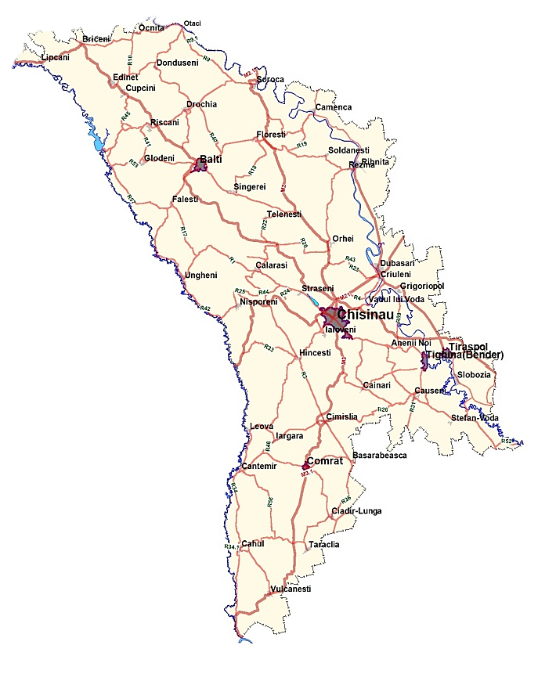
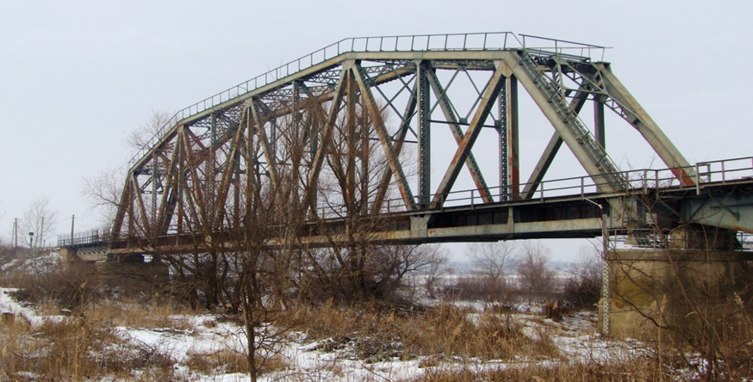
LOCATION OF NEW CONNECTION

Slide 3
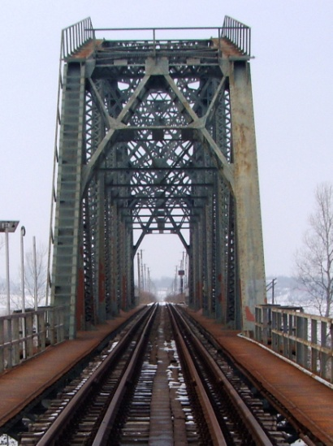
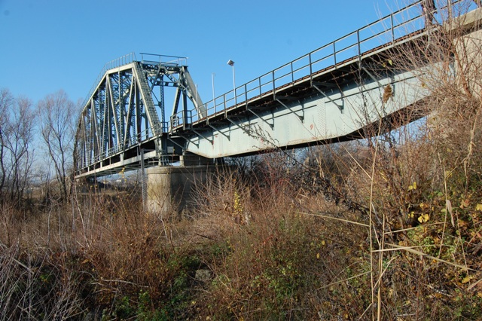
Existing railroad Bridge
The rail road bridge is not used for 20 years.

Slide 4
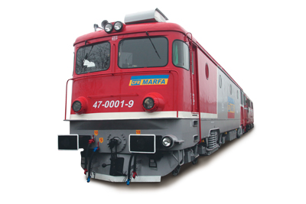
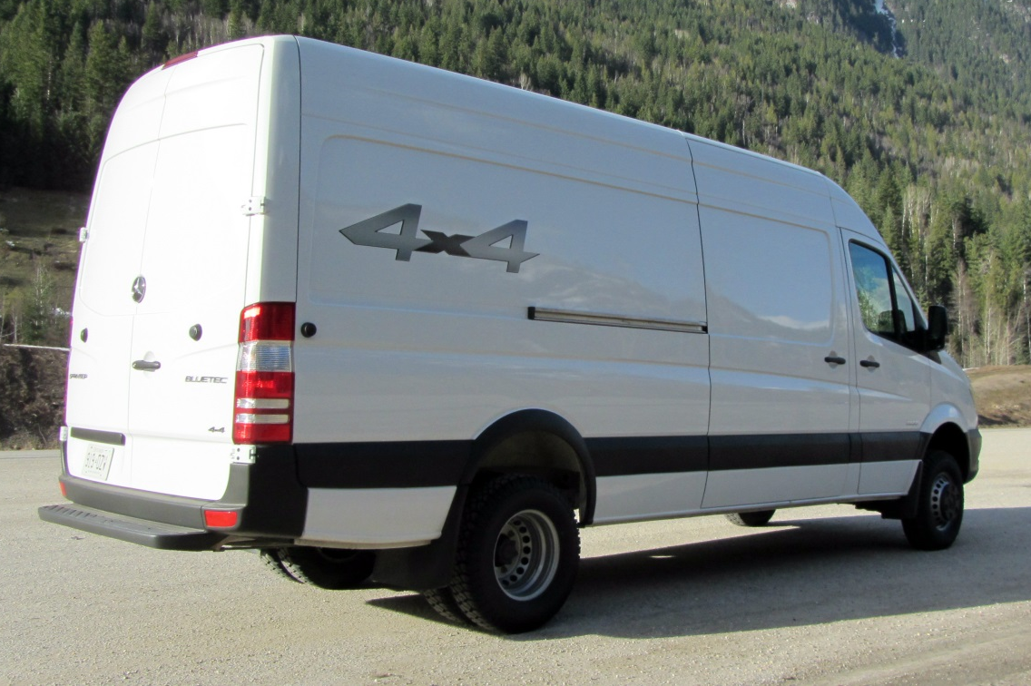
Existing railroad Bridge
RAIL TRANSPORT
+
AUTO TRANSPORT

Slide 5
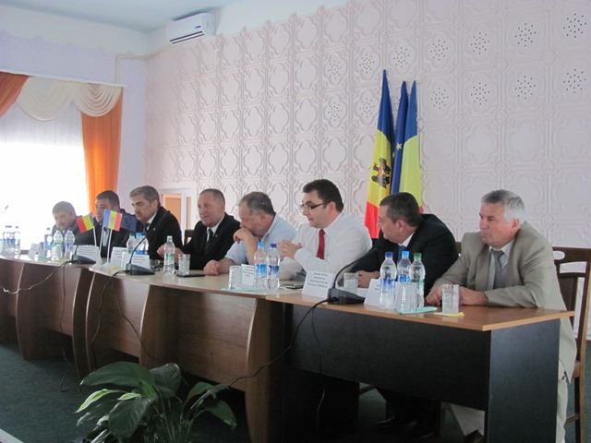
Existing railroad Bridge
Idea was agreed at local level from both part of Prut river (Moldova and Romania)
Elaboration of Study regarding adoption of the railroad bridge.

Slide 6
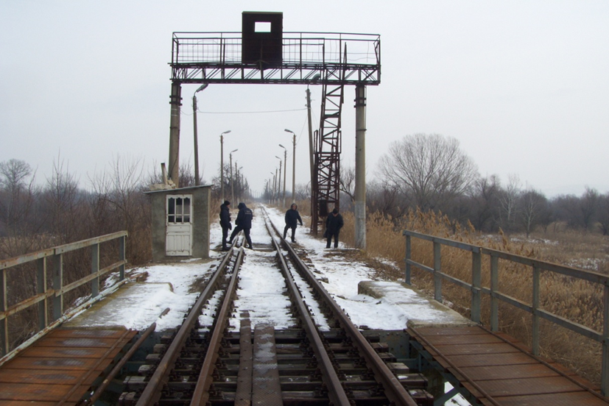
Existing railroad Bridge
Moldavian part elaborated a study regarding modification of existing rail road bridge to permit cars crossing.
Study was proposed to the Ministry of Transport of Romania.

Slide 7
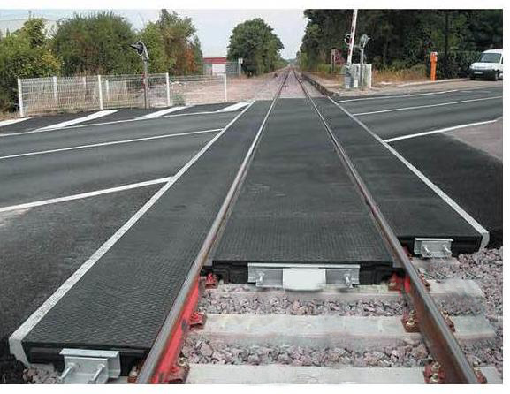
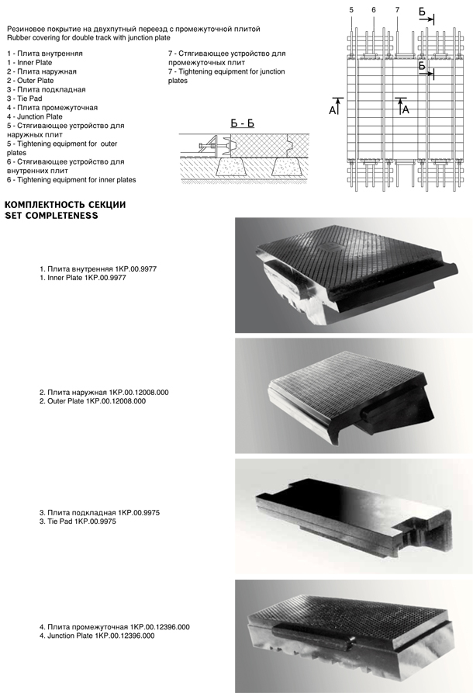
CHANGE of the Existing railroad Bridge

Slide 8
BENEFITS AND COSTS
The project :
significant reduce journey time;
considerable reduction of the traveled distance;
significant economic growth potential;
this is a regional project connecting Moldova with Romania;
it contributes to regional cohesion and will assist in the development of connections for passengers and freight in the Eastern Partnership countries.
Estimated costs for modification of bridge and access road construction – 3.5 mil. Euro

Slide 9
Thank You for Attention
Ministry of Transport and Road Infrastructure
Republic of Moldova
www.mtid.gov.md

