Slide 1
Georgia
Brussels, March 14, 2017
Presented by Nugzar Gasviani
Deputy Chairmen – Technical Secretary
Road Department of Georgia
Ministry of Regional Development and Infrastructure
Notes:
1

Slide 2
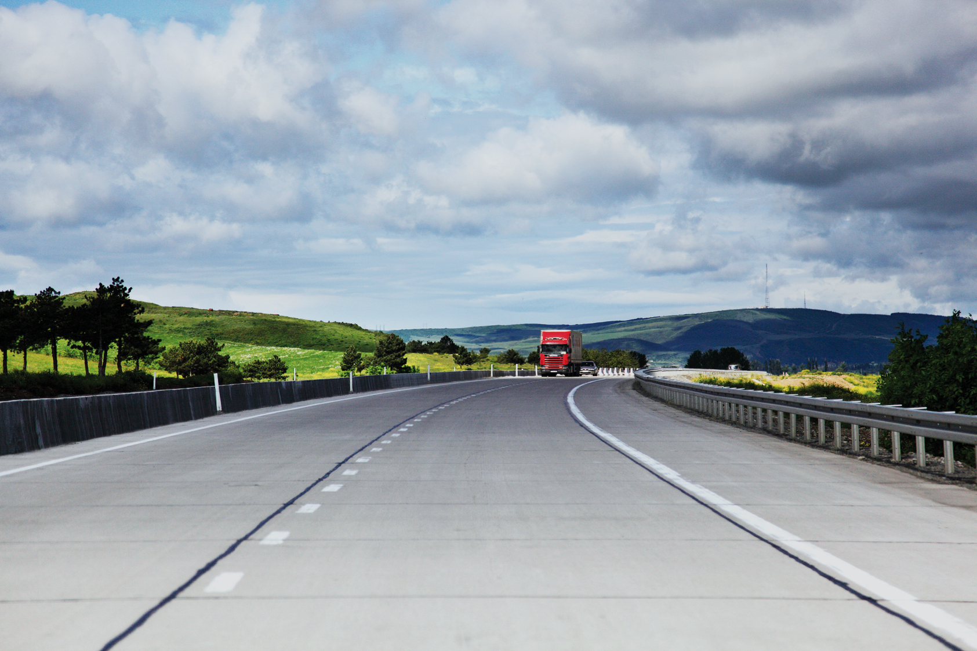
TEN-T Road Network of Georgia
Pipeline – 2017-2020
www.mrdi.gov.ge
www.georoad.ge

Slide 3
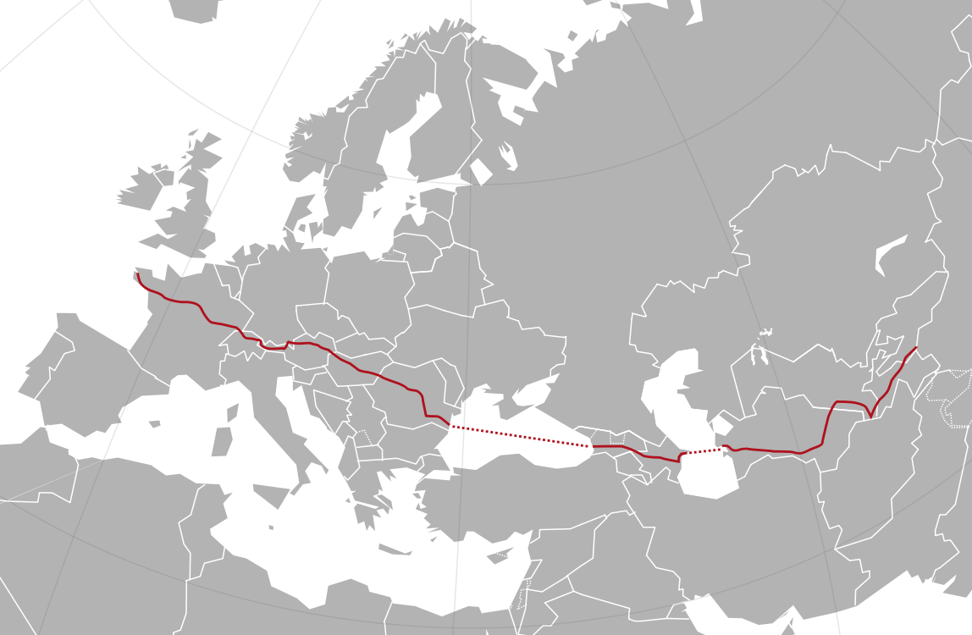
E60 TEN-T Road
China
France
E60
Georgia
E60

Slide 4
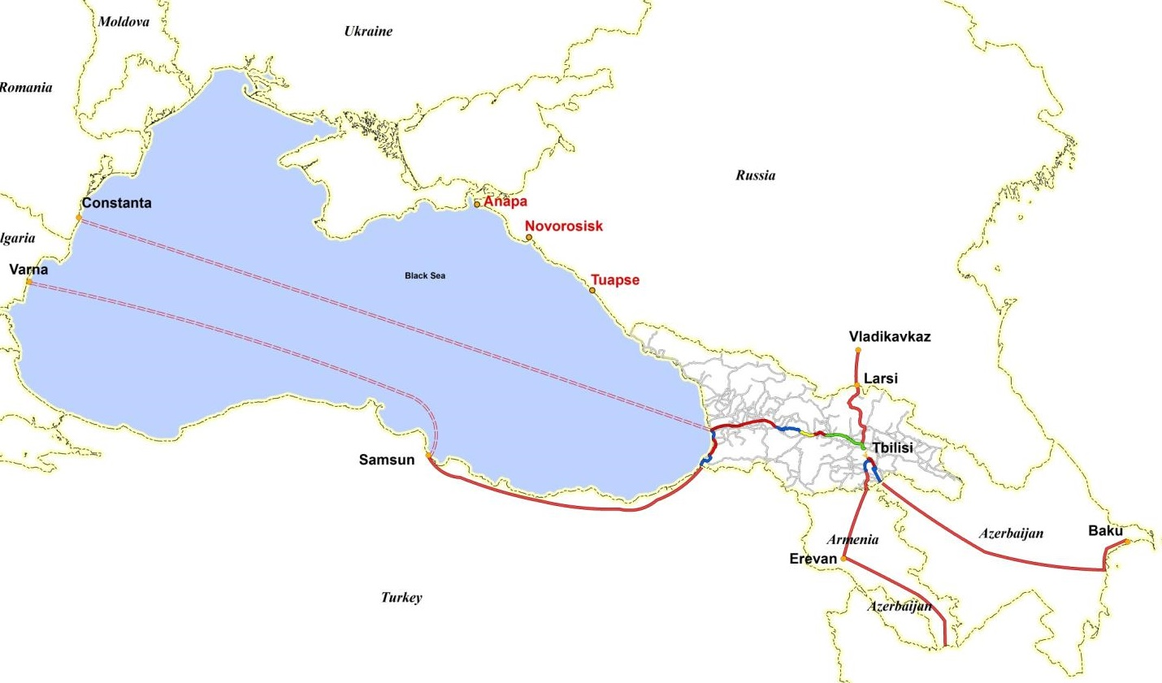
Trans European Road Network
E-60
E-70
E-60
E-60
E-117
E-70
Red Bridge
E-60
E-117

Slide 5
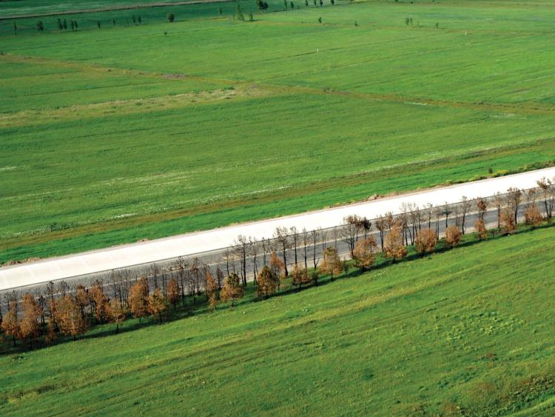
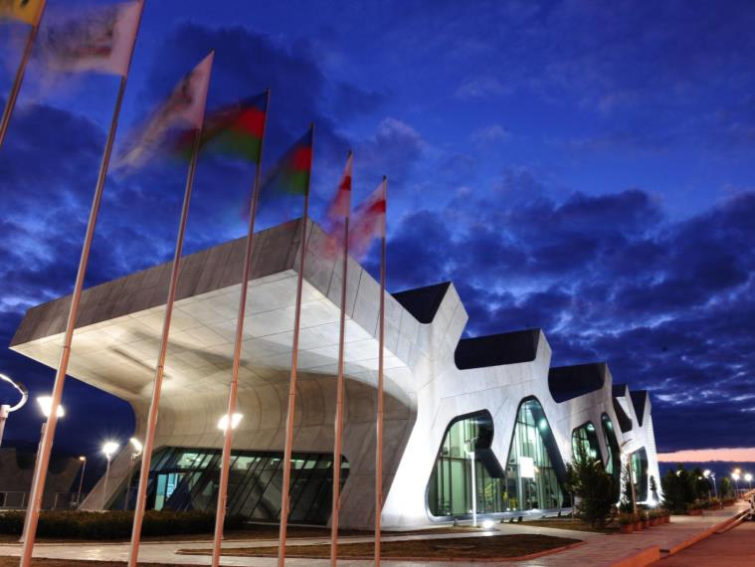
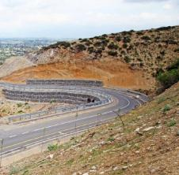
Ministry of Regional Development and Infrastructure
Main Challenges 2017-2020
Roads Department of Georgia
More than 800 km road network upgrade and construction projects.
Estimated 3.5 billion USD planned capital investment.
Tourism
Mobility
Supporting economic activities and creating jobs in regions
w
z
Social mobility and
Securing life line roads
Education/Healtcare

Providing preconditions for welfare improvement
Agriculture
Supporting the production of high value agricultural products
A
Core
Business
Safety
Eliminating number of death and serious injuries
h

K
Environment
Improving the required qualities for sustainable growth

Slide 6
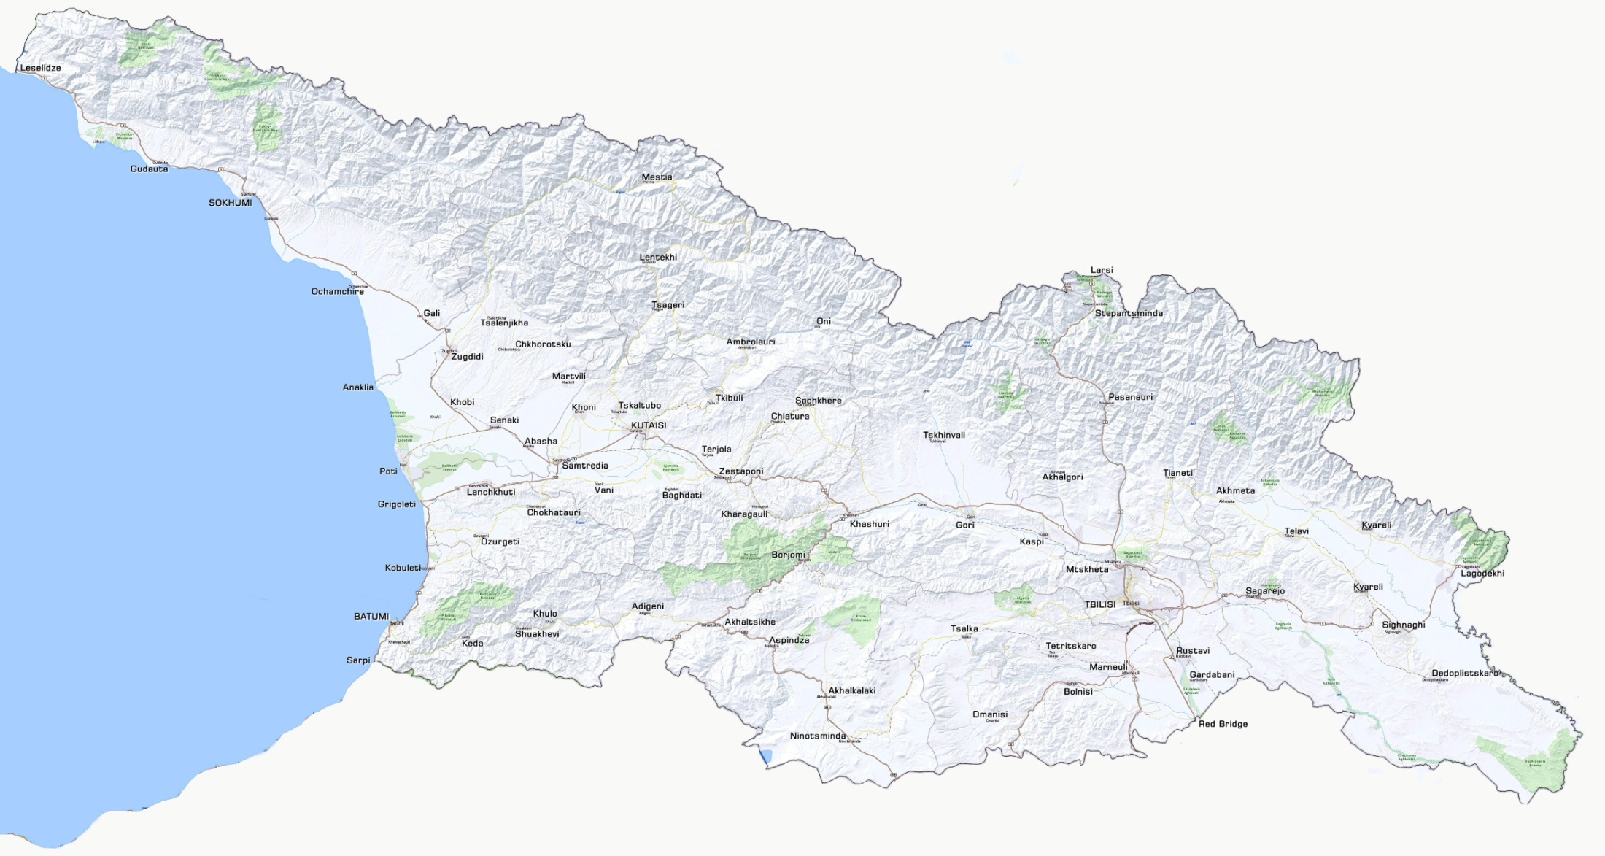
TEN-T Highway Network – 600km
Completed Sections – 150 km
Ongoing Sections – 100 km
Planned Sections – 200km
Russia
Prospective Sections – 150 km
Turkey
Armenia
Azerbaijan

Slide 7
Planned and Prospective Projects

Slide 8
Tbilisi – Bypass / Red Bridge / Sadakhlo/Jinvali
Section | Length | Cost Mln USD
Rustavi-Red bridge | 35km | 110
Rustavi-Sadakhlo | 40km | 90
Natakhtari-Jinvali | 28km | 130
Tbilisi bypass | 55km | 350
Russia
Anaklia Deep Sea Port
(Planned)
Poti Port
Batumi Port
Planned Sections
Prospective Sections
Turkey
Armenia
Azerbaijan

Slide 9
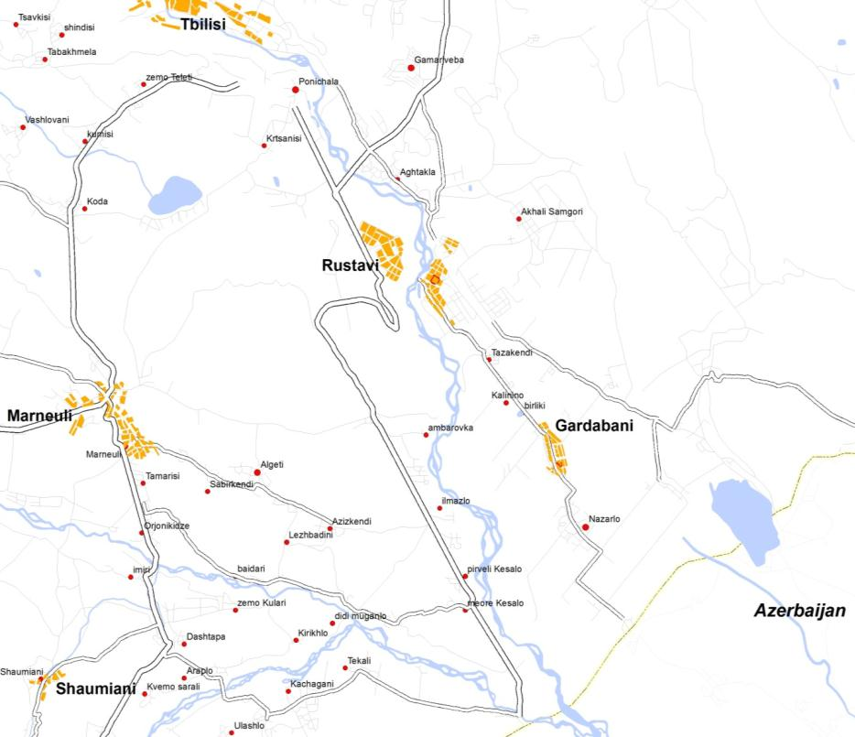
Rustavi – Red Bridge 35 km
Project Data:
Status: FS and DD is ongoing.
Estimated Cost: 110 mln. USD.
Design Period: 2017 – 2018
Construction Period: 2018 – 2020
Donor: Consultations with EIB

Slide 10
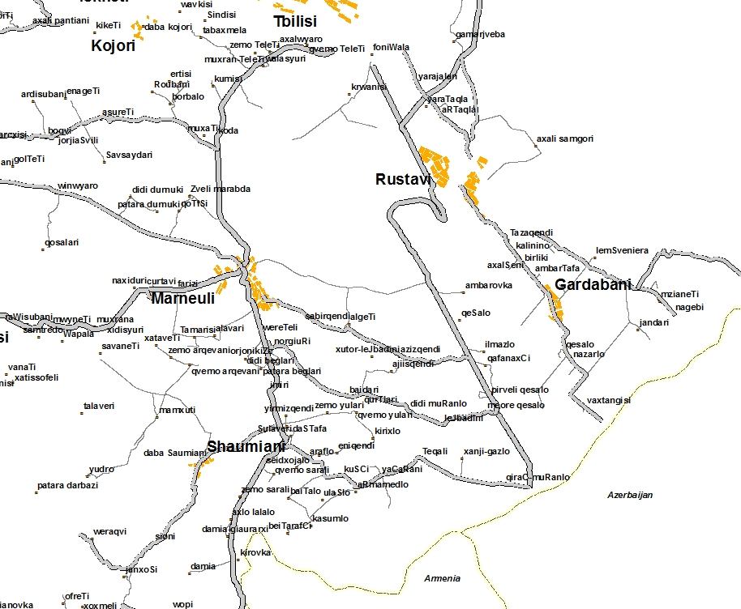
Rustavi – Sadakhlo 40 km
Project Data:
Status: FS and DD is ongoing.
Estimated Cost: 90 mln. USD.
Design Period: 2017 – 2018
Construction Period: 2018 – 2020
Donor: EIB

Slide 11
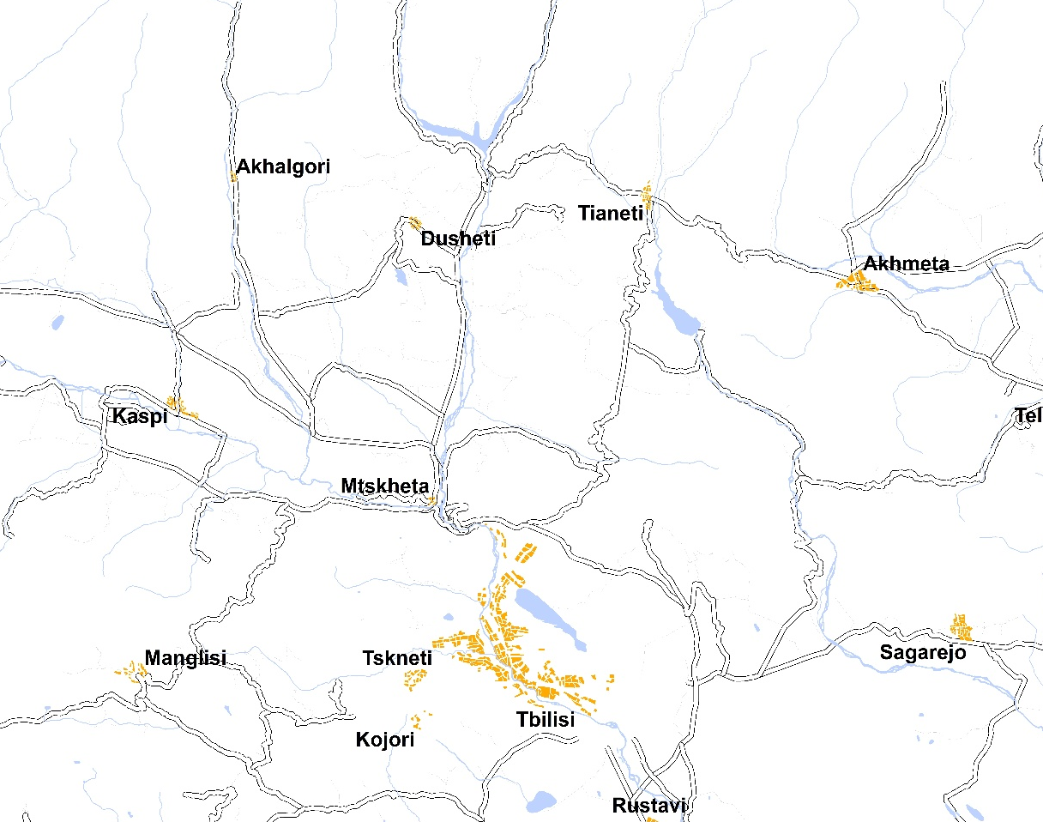
Natakhtari-Jinvali (28km)
Project Data:
Status: FS and DD is ongoing.
Estimated Cost: 130 mln. USD.
Design Period: 2016 – 2017
Construction Period: 2018 – 2020
Donor: N/A

Slide 12
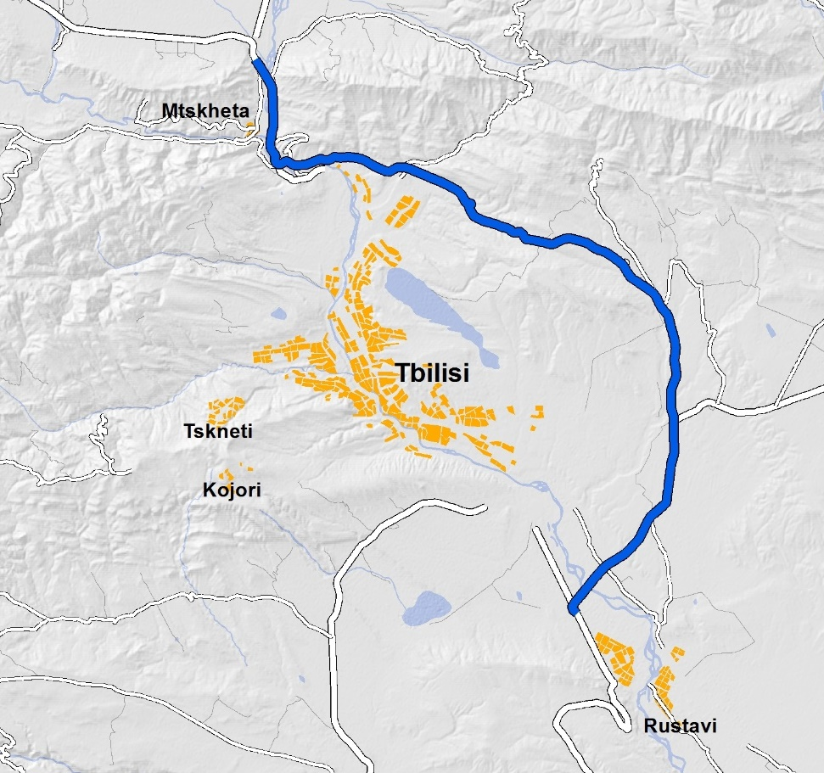
Tbilisi Bypass (55km)
Project Data:
Status: Bidding for FS and DD is ongoing.
Estimated Cost: 350 mln. USD.
Design Period: 2016 – 2017
Construction Period: N/A
Donor: N/A

Slide 13
Chumateleti - Argveta
Section | Length | Cost Mln USD
Chumateleti-Khevi (F1) | 11.1km | 120
Khevi-Ubisa (F2) | 15.4km | 210
Ubisa-Shorapani (F3) | 10.5km | 260
Shorapani-Argveta (F4) | 15.8km | 230
Russia
Anaklia Deep Sea Port
(Planned)
Poti Port
Batumi Port
Turkey
Armenia
Azerbaijan

Slide 14
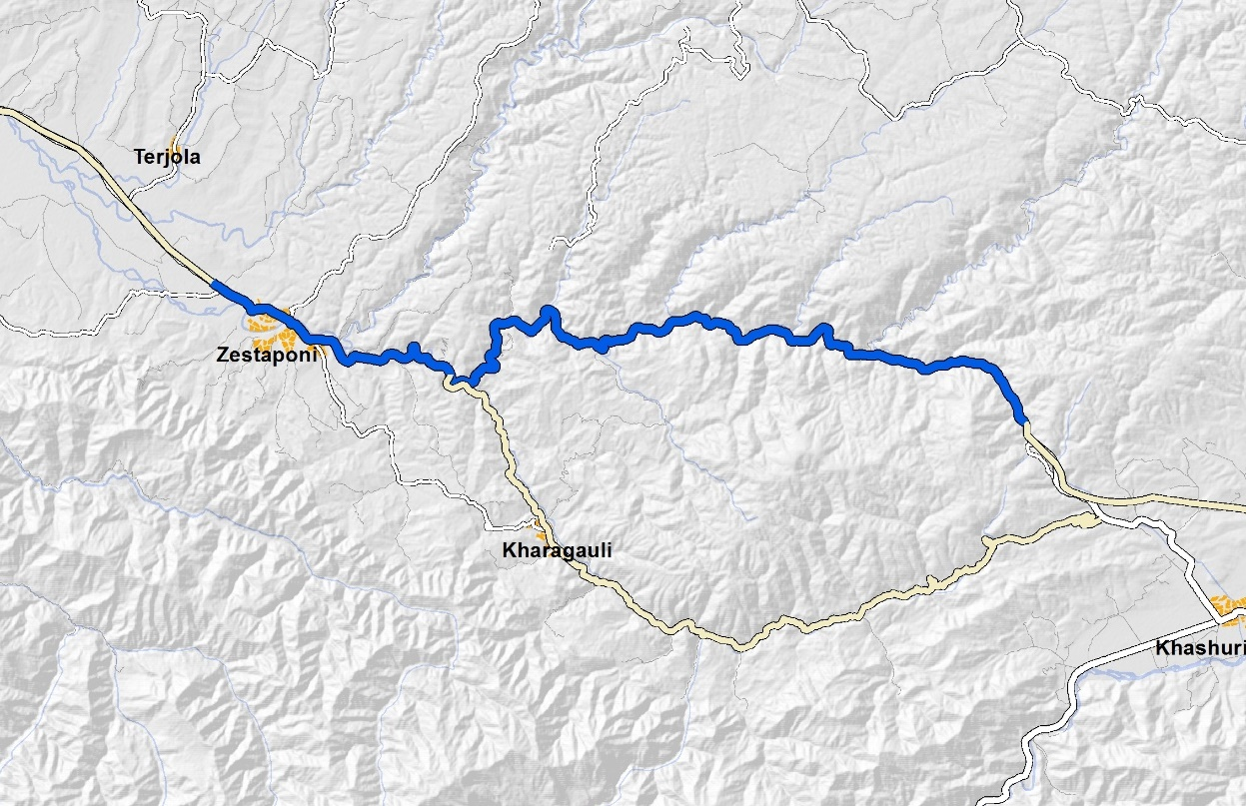
Chumateleti – Argveta (53km) 4-lane
Project Data:
Status: DD is ongoing.
Estimated Cost: 820 mln. USD.
Design Period: 2017 – 2018
Construction Period: 2018 – 2020
Donor: Multi donor project. Consultations with WB, ADB, AIIB, EIB, JICA, EDCF Korea

Slide 15
Grigoleti – Choloqi – Poti
Russia
Section | Length | Cost Mln USD
Grigoleti-Choloki | 14km | 80
Grigoleti-Poti | 24km | 100
Anaklia Deep Sea Port
(Planned)
Poti Port
Batumi Port
Turkey
Armenia
Azerbaijan

Slide 16
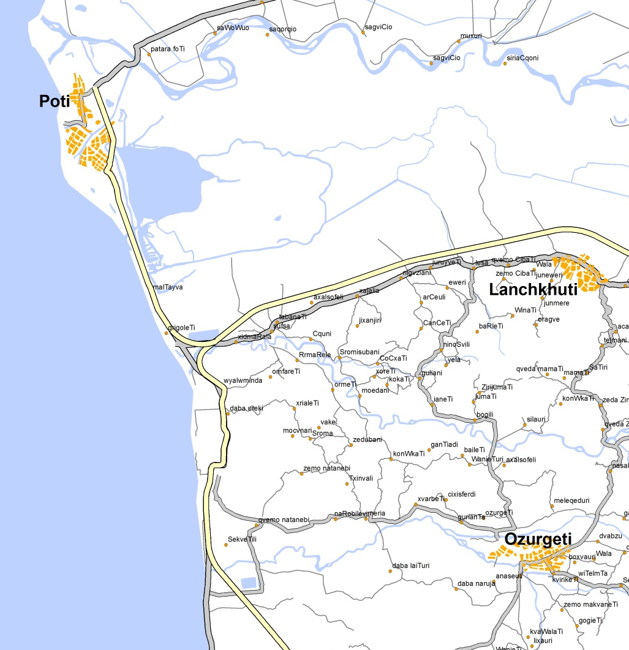
Grigoleti – Choloqi
Project Data:
Status: DD is ongoing.
Estimated Cost: 80mln. USD.
Design Period: 2017 – 2018
Construction Period: 2018 – 2020
Donor: EIB

Slide 17
Grigoleti – Poti
Project Data:
Status: DD is ongoing.
Estimated Cost: 100mln. USD.
Design Period: NA
Construction Period: NA
Donor: Consultation with EIB

Slide 18
Batumi - Sarpi
Russia
Anaklia Deep Sea Port
(Planned)
Poti Port
Batumi Port
Turkey
Armenia
Azerbaijan

Slide 19
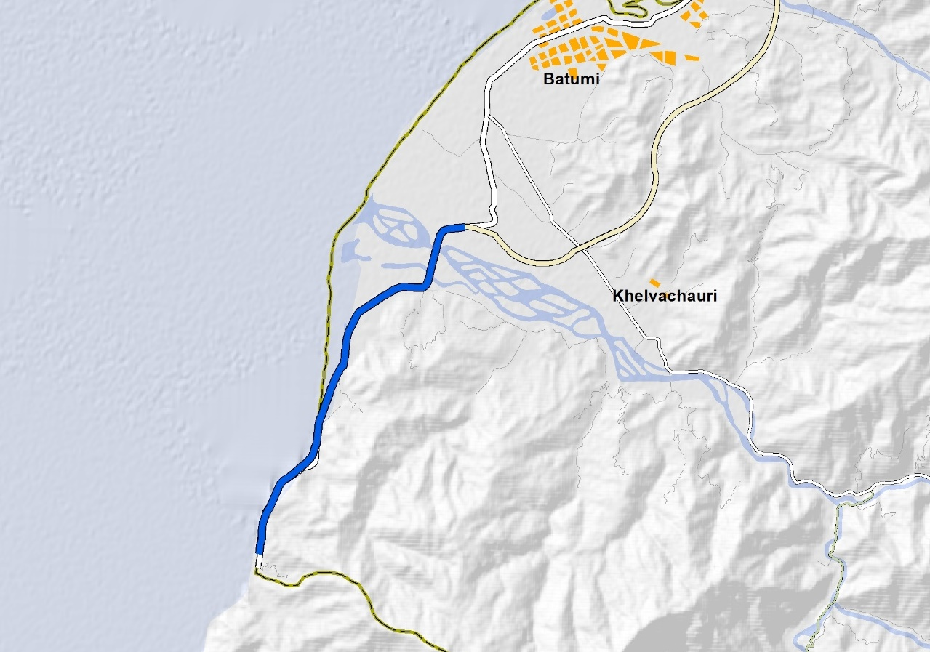
Batumi (Tchorokhi) – Sarpi (11km)
Project Data:
Status: Bidding for FS and DD is ongoing.
Estimated Cost: 110 mln. USD.
Design Period: 2017 – 2018
Construction Period: 2018 – 2020
Donor: Consultation with ADB

Slide 20
Samtredia – Zugdidi Bypass including new Anaklia Port connection
Section | Length | Cost Mln USD
Samtredia – Zugdidi Bypass) | 72 km | 140
Anaklia Port Connection | 18 km | 60
Russia
Anaklia Deep Sea Port
(Planned)
Poti Port
Batumi Port
Turkey
Armenia
Azerbaijan

Slide 21
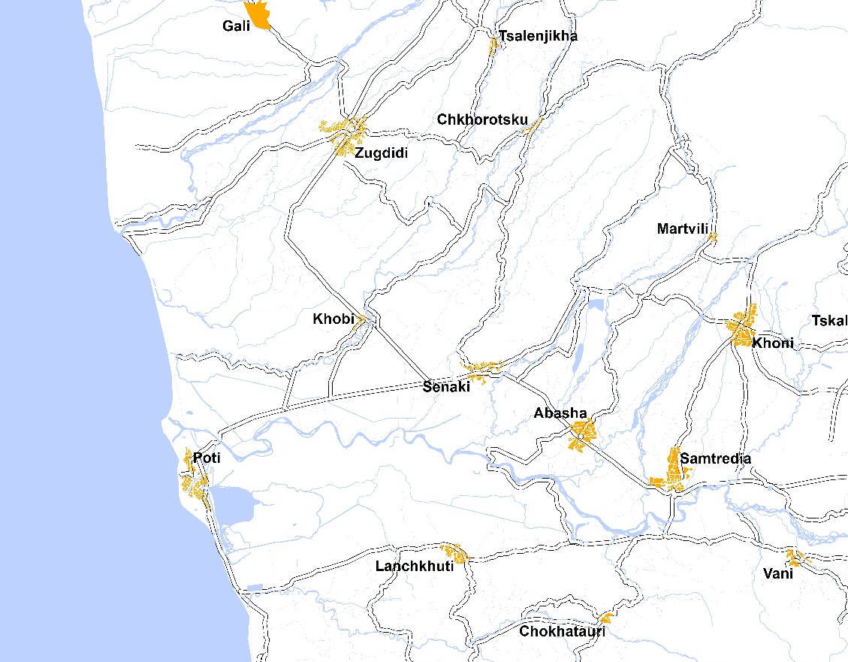
Access road to Anaklia port
Project Data:
Status: PFS and FS is ongoing.
Estimated Cost: 60 mln. USD.
Design Period: 2017– 2018
Construction Period: 2018 – 2020
Donor: N/A
Following road will be the main Access Road for Anaklia Deep Sea Port. Construction of Anaklia port is planned to be Completed by year 2020.

Slide 22
Samtredia – Zugdidi Bypass
Project Data:
Status: PFS and FS is ongoing.
Estimated Cost: 140 mln. USD.
Design Period: 2017– 2018
Construction Period: N/A
Donor: N/A

Slide 23
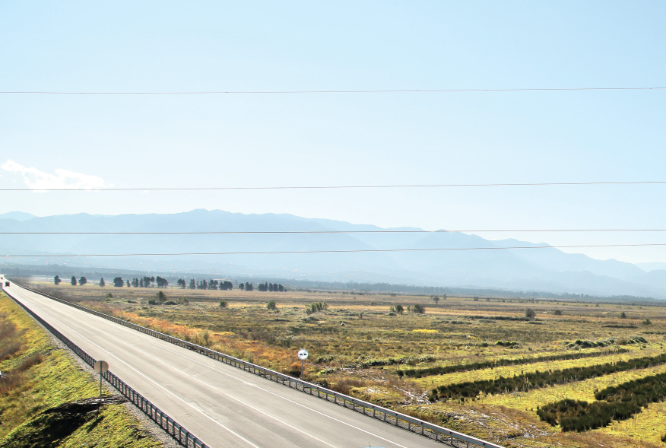
WB – World Bank
EU – European Union
Donors and Partners
EIB – European Investment Bank
ADB – Asian Development Bank
JICA – Japan International Cooperation Agency
AIIB – Asian Infrastructure Investment Bank
Korea Economic Development Co-operation Fund
Kuwait Fund

Slide 24
Thank you

