Slide 1
12 MEETING
TRANSPORT PANEL
EASTERN PARTNERSHIP

Slide 2
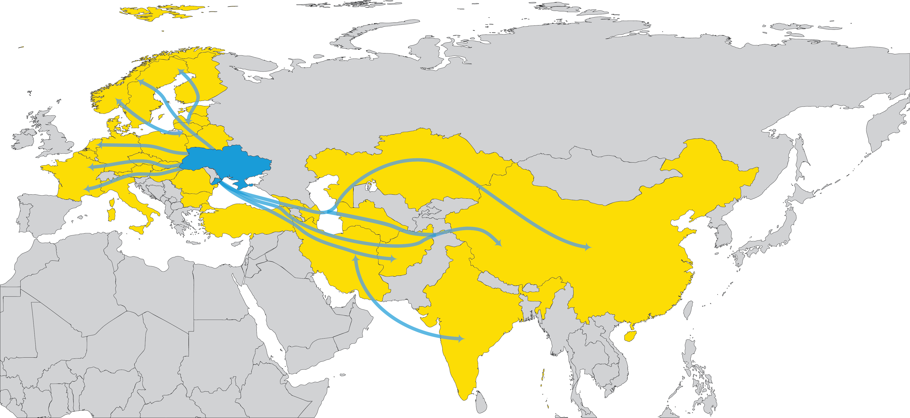
EUROPE-ASIA
CONNECTIONS

Slide 3
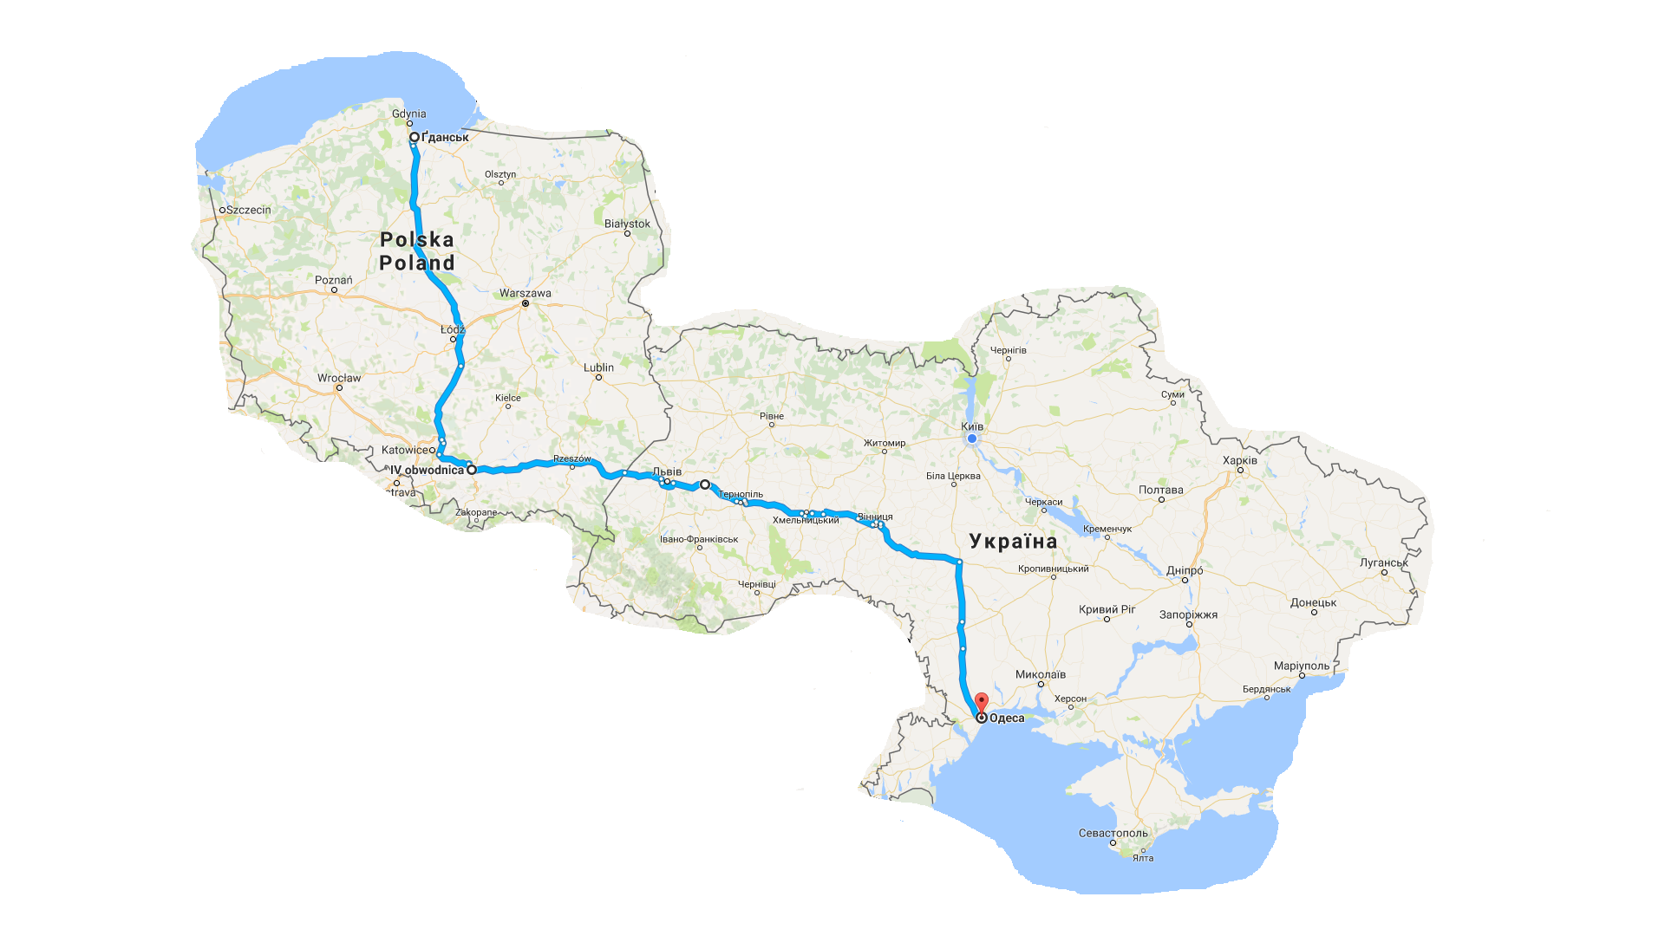
ROAD CONNECTIONS
GO PROJECT
●
E 75
E 40
E 50
Ukraine
E 95

Slide 4
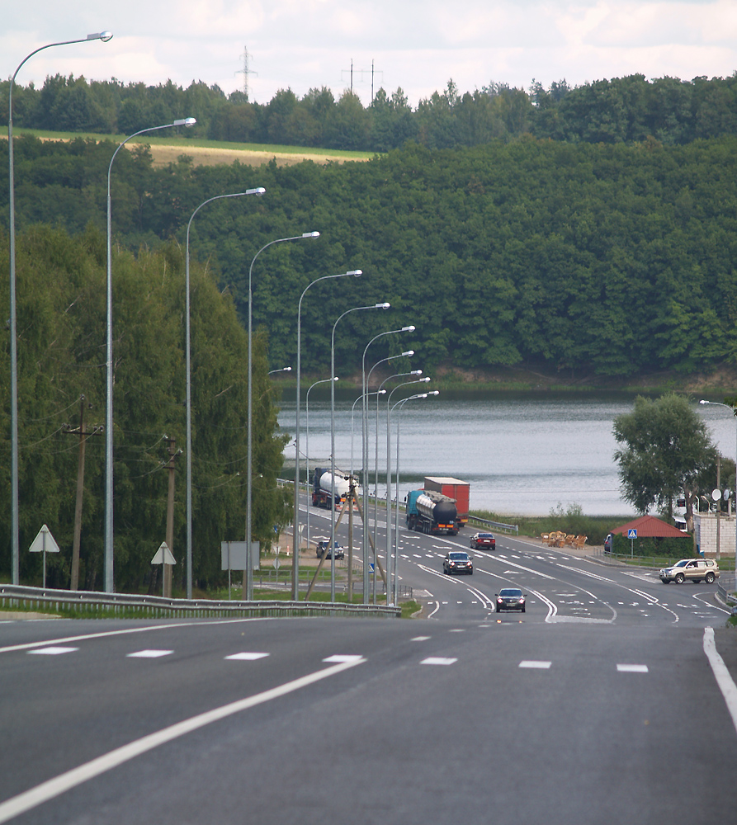
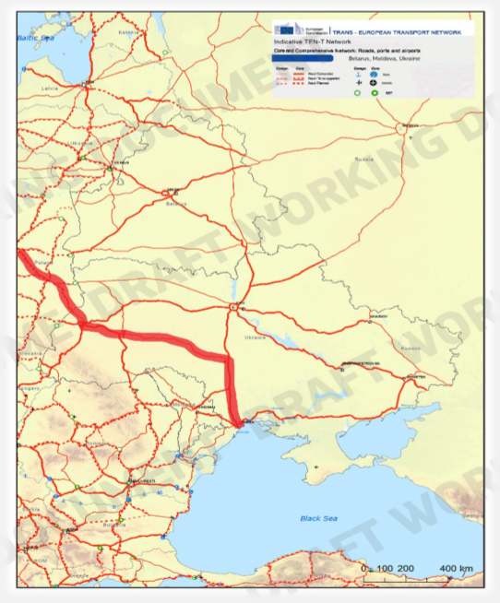
ROAD CONNECTIONS
GO PROJECT
Route projected to reduce transit time between Gdansk/Gdynia and Odesa seaports from 23 hours to 15 hours
Benefits
Improves speed rate for cargo flows
Reconstruction of road from Category-2 upgrading to Category-1
Includes construction of bypasses around residential areas

Slide 5
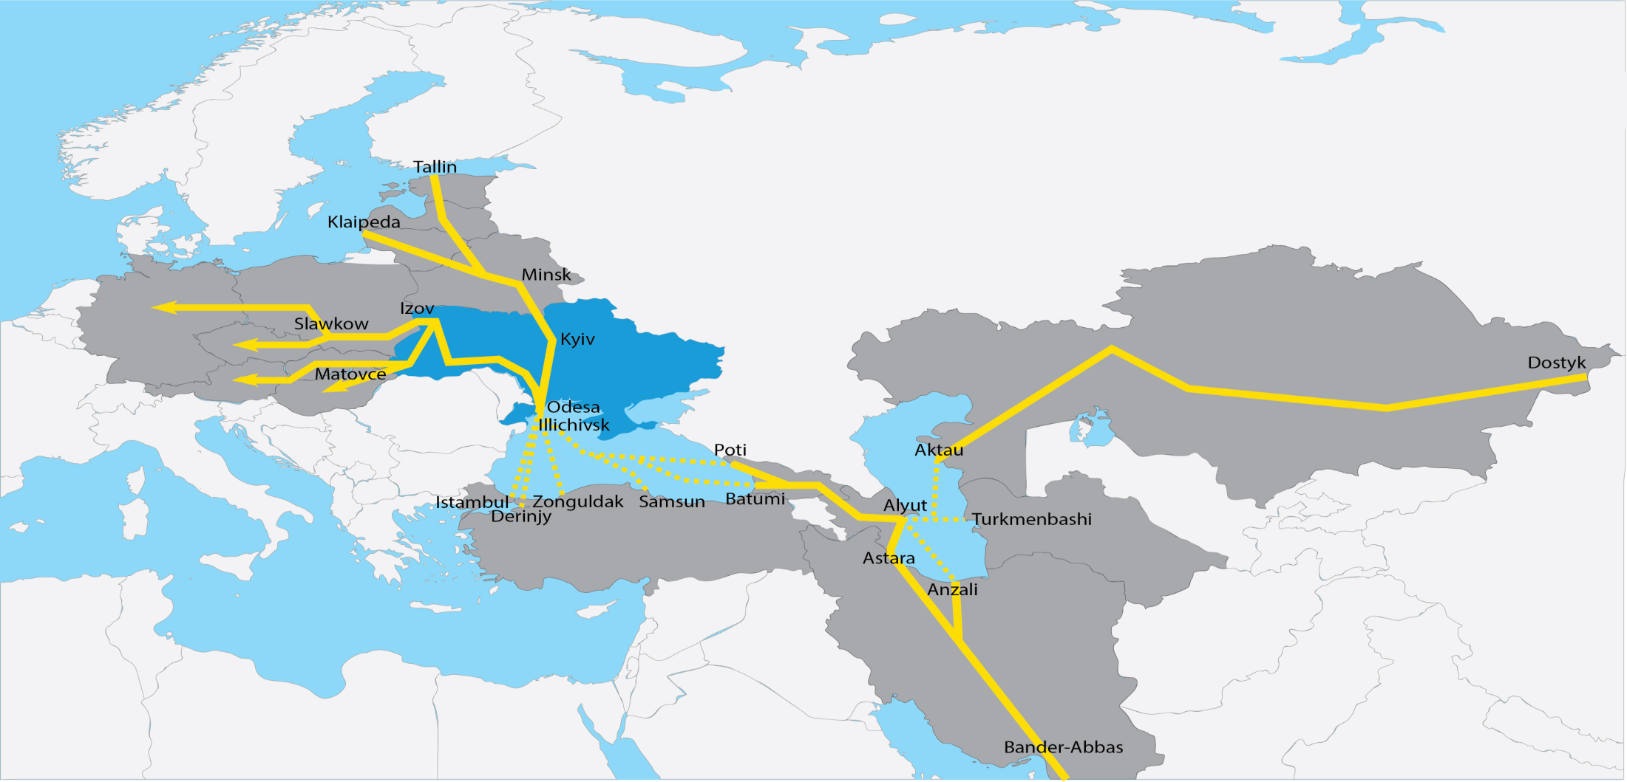
EUROPE-ASIA RAILWAY
CONNECTIONS
●

Slide 6
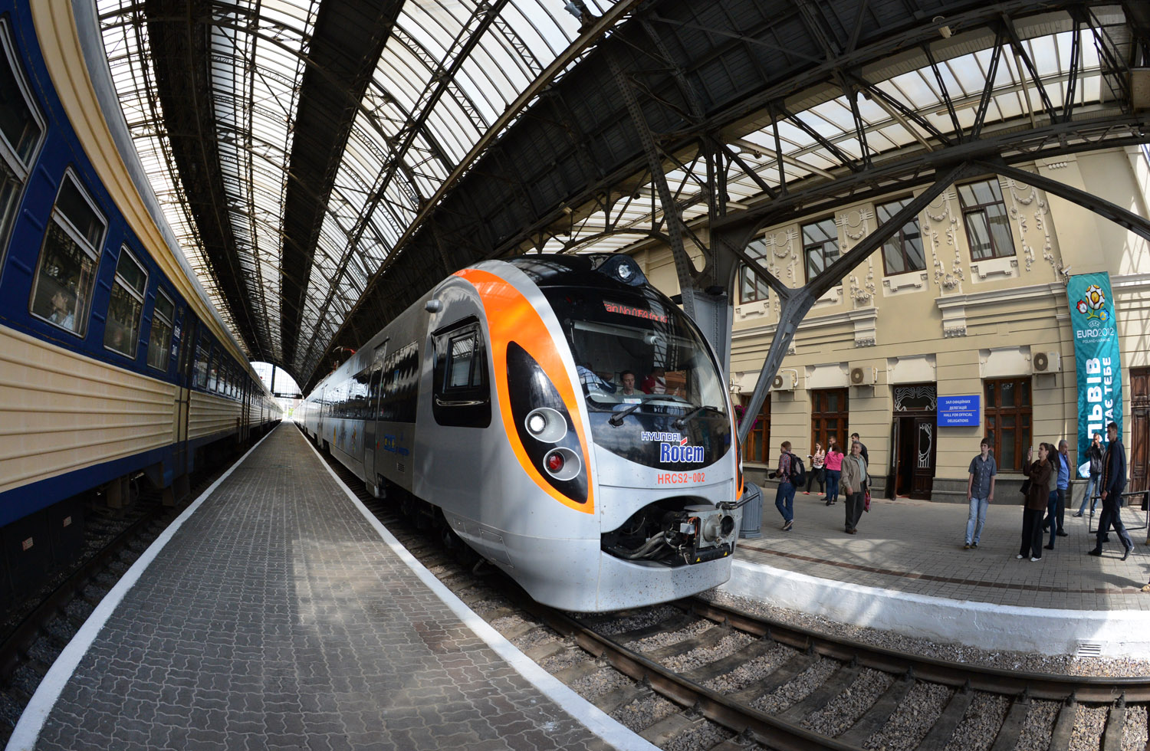
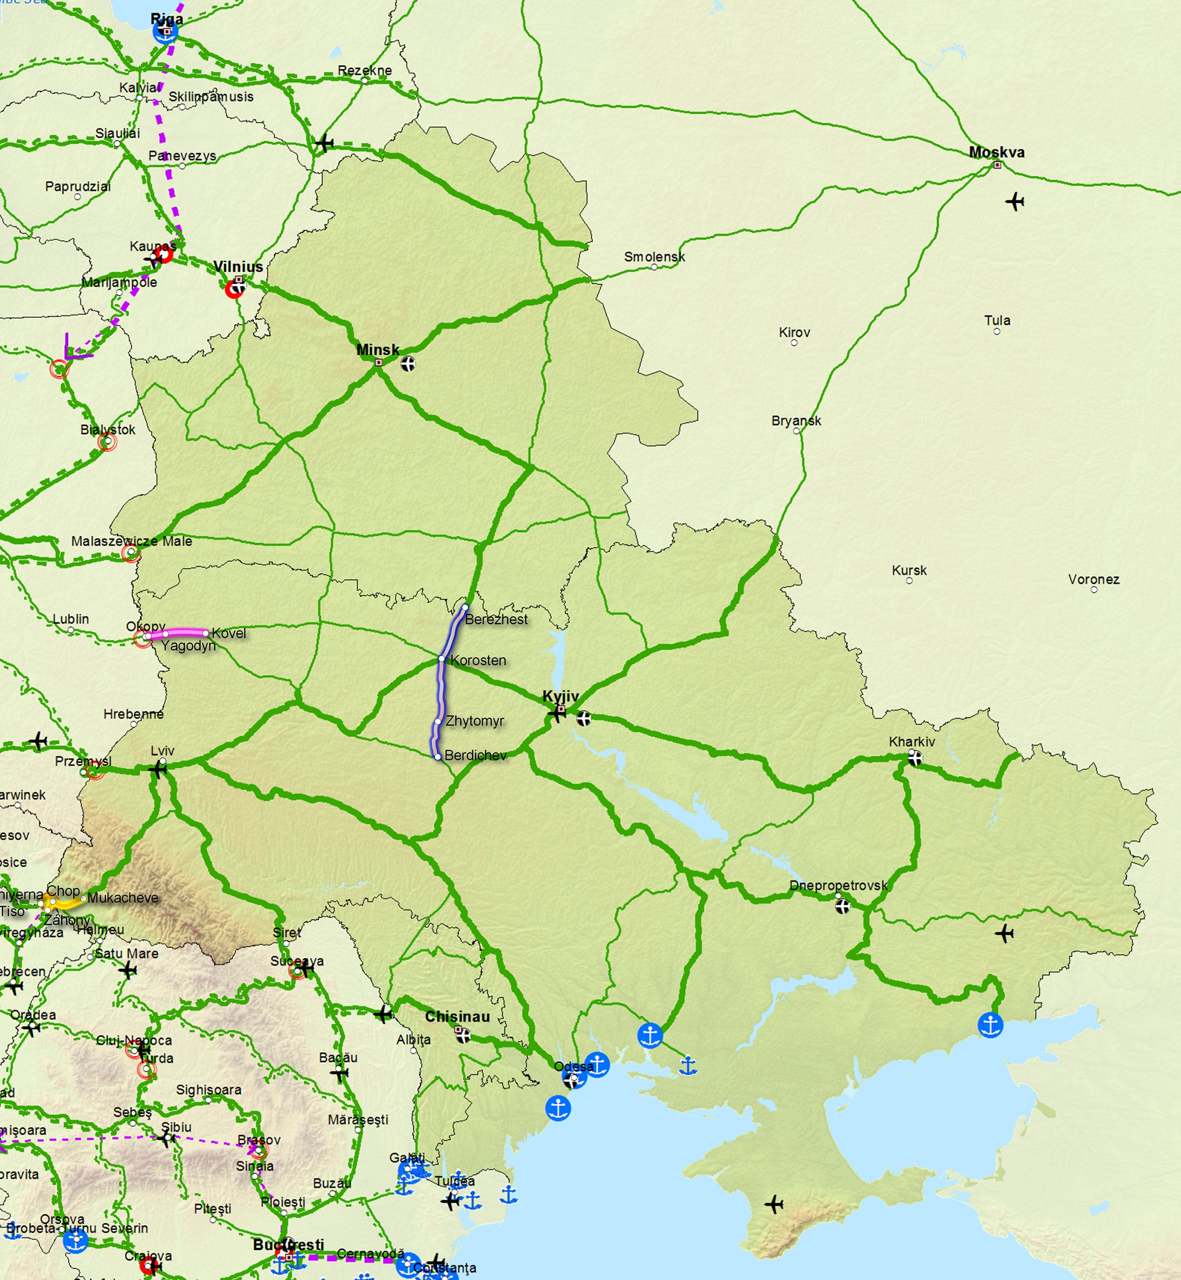
RAILWAY
CONNECTIONS
Electrification of the railway section Berdychiv – Korosten – Berezhest
Cost – 139,6 MLN. EURO.
Modernization of the railway gauge1435 mm on the section Kovel – Yagodyn – state border with further electrification з
Cost – 50 MLN. EURO.
Restoration of passenger connection пасажирського сполучення Mukachevo – Chop – Zahony (Hungary)/Chierna-nad -Tisoj (Slovak Republic)
Cost – 6,4 MLN. EURO.

Slide 7
THANK YOU FOR ATTENTION!

