Slide 1
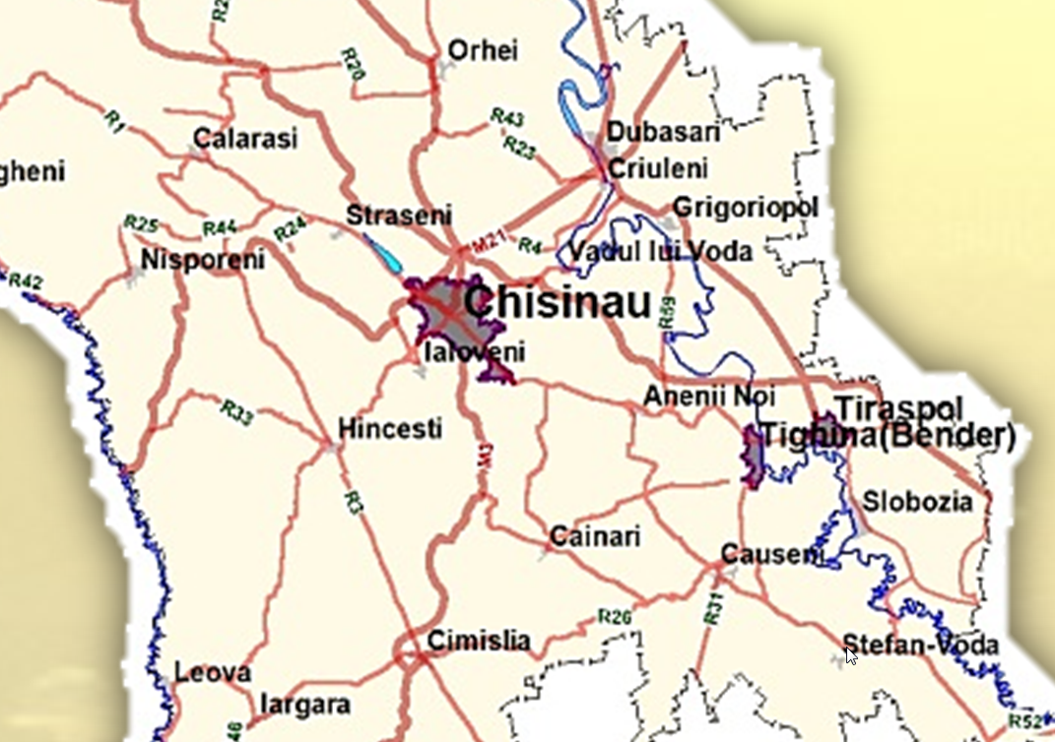
RING OF CHISINAU AS PART OF TENT - NETWORK
Chisinau 2017

Slide 2
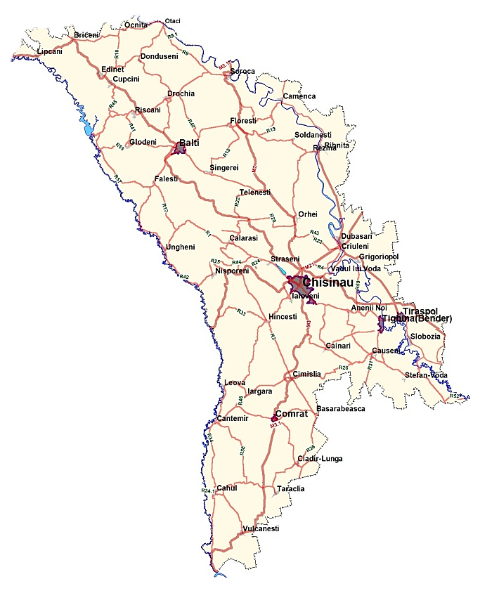
Extended Trans-European Network TEN-T
Trans – European Transport Network TEN-T
Modification of TEN-T

Slide 3
Ring of Chisinau connection of TEN-T Network
M1 – Romanian border road,
km 6- km 14 section (8 km modernization);
Was elaborated feasibility study and technical documentation for modernization. The project includes extension from 2 to 4 lanes and modernization of 5 intersections.
The project cost is 17 mil. Euro.
Source of funding need to be identified.

Slide 4
Ring of Chisinau connection of TEN-T Network
M21Chisinau – Dubasari – Poltava road,
section km 5 - km 15
(10 km modernization);
Was elaborated feasibility study and technical documentation for modernization. The project includes extension from 2 to 4 lanes, modernization of 4 intersections.
The project cost is 25,7 mil. Euro.
Source of funding need to be identified.

Slide 5
Ring of Chisinau connection of TEN-T Network
M14 Brest – Chisinau – Odessa road, sector km 265 - km 275 (10 km modernization);
Feasibility study and technical documentation for modernization will be elaborated in 2017. The project will include extension from 2 to 4 lanes and modernization of an intersection.
The project cost is 15,0 mil. Euro

Slide 6
Ring of Chisinau connection of TEN-T Network
Link construction between national road M14 Brest – Briceni –Chisinau – Tiraspol – Odessa (km 275) and R2 Chisinau-Bender (km 18,5), approximate length 17 km (new construction)
In 2016 will be elaborated feasibility study and technical documentation for modernization. The project will include new construction of 4 lanes road.
The project cost is estimated to 46,0 mil. Euro.
Source of funding need to be identified.

Slide 7
Ring of Chisinau connection of TEN-T Network
Link construction between national road R2 Chisinau-Bender (km 18,5) and R3 Chisinau – Hincesti – Basarabeasca (km 10), approximate length 32 km (new construction) ;
In 2016 will be elaborated feasibility study (prefeasibility study elaborated) and technical documentation for modernization. The project will include new construction of 4 lanes road.
The project cost is estimated to 86,4 mil. Euro.
Source of funding need to be identified.

Slide 8
Ring of Chisinau connection of TEN-T Network
R6 M1- Ialoveni road,
km 0 – km 6,6 (6,6 km length, now in rehabilitation);
Cost of rehabilitation – 8,9 mil. Euro, financed by EBI.
Project is under rehabilitation now. End of works is planned for 2017.
The project includes rehabilitation of the existing road, upgrading an intersection, consolidation of a sector hit by landslides etc.

Slide 9
Thank You for Attention
Ministry of Transport and Road Infrastructure
Republic of Moldova
www.mtid.gov.md

