Slide 1
Proposal for Financing Balti - Criva road sector rehabilitation
Chisinau 2017

Slide 2
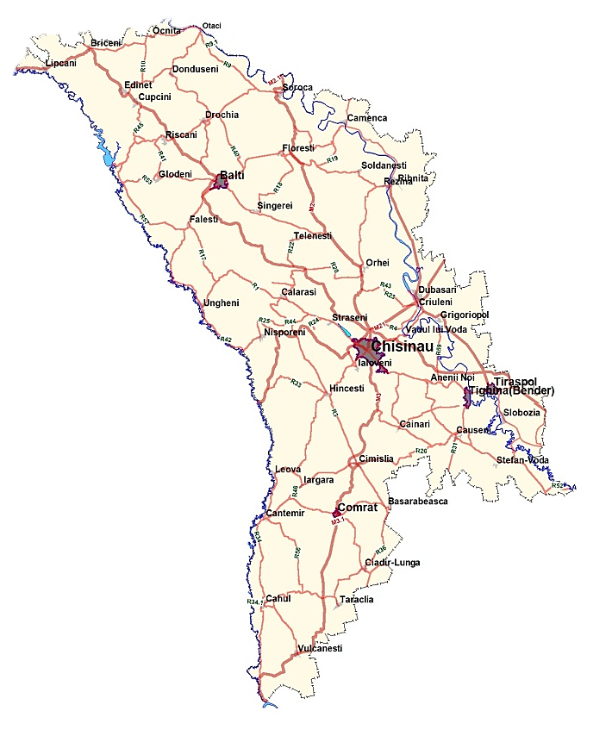
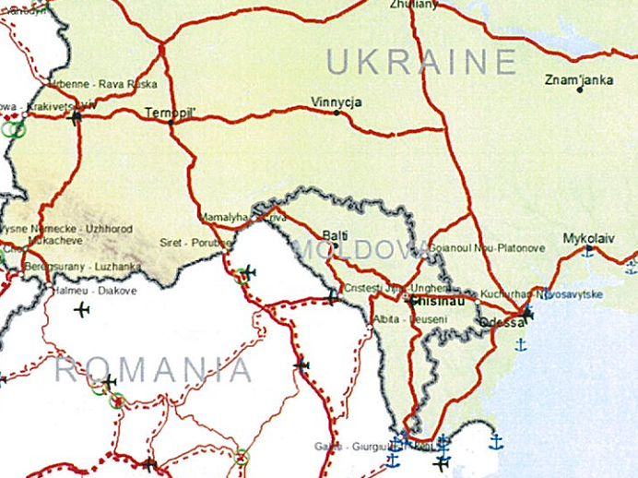
International importance of the M14 Criva – Balti–Chisinau–Tiraspol–Ukrainian border road
Connection of the national network to the TRANS-EUROPEAN NETWORKS Transport (TEN-T)

Slide 3
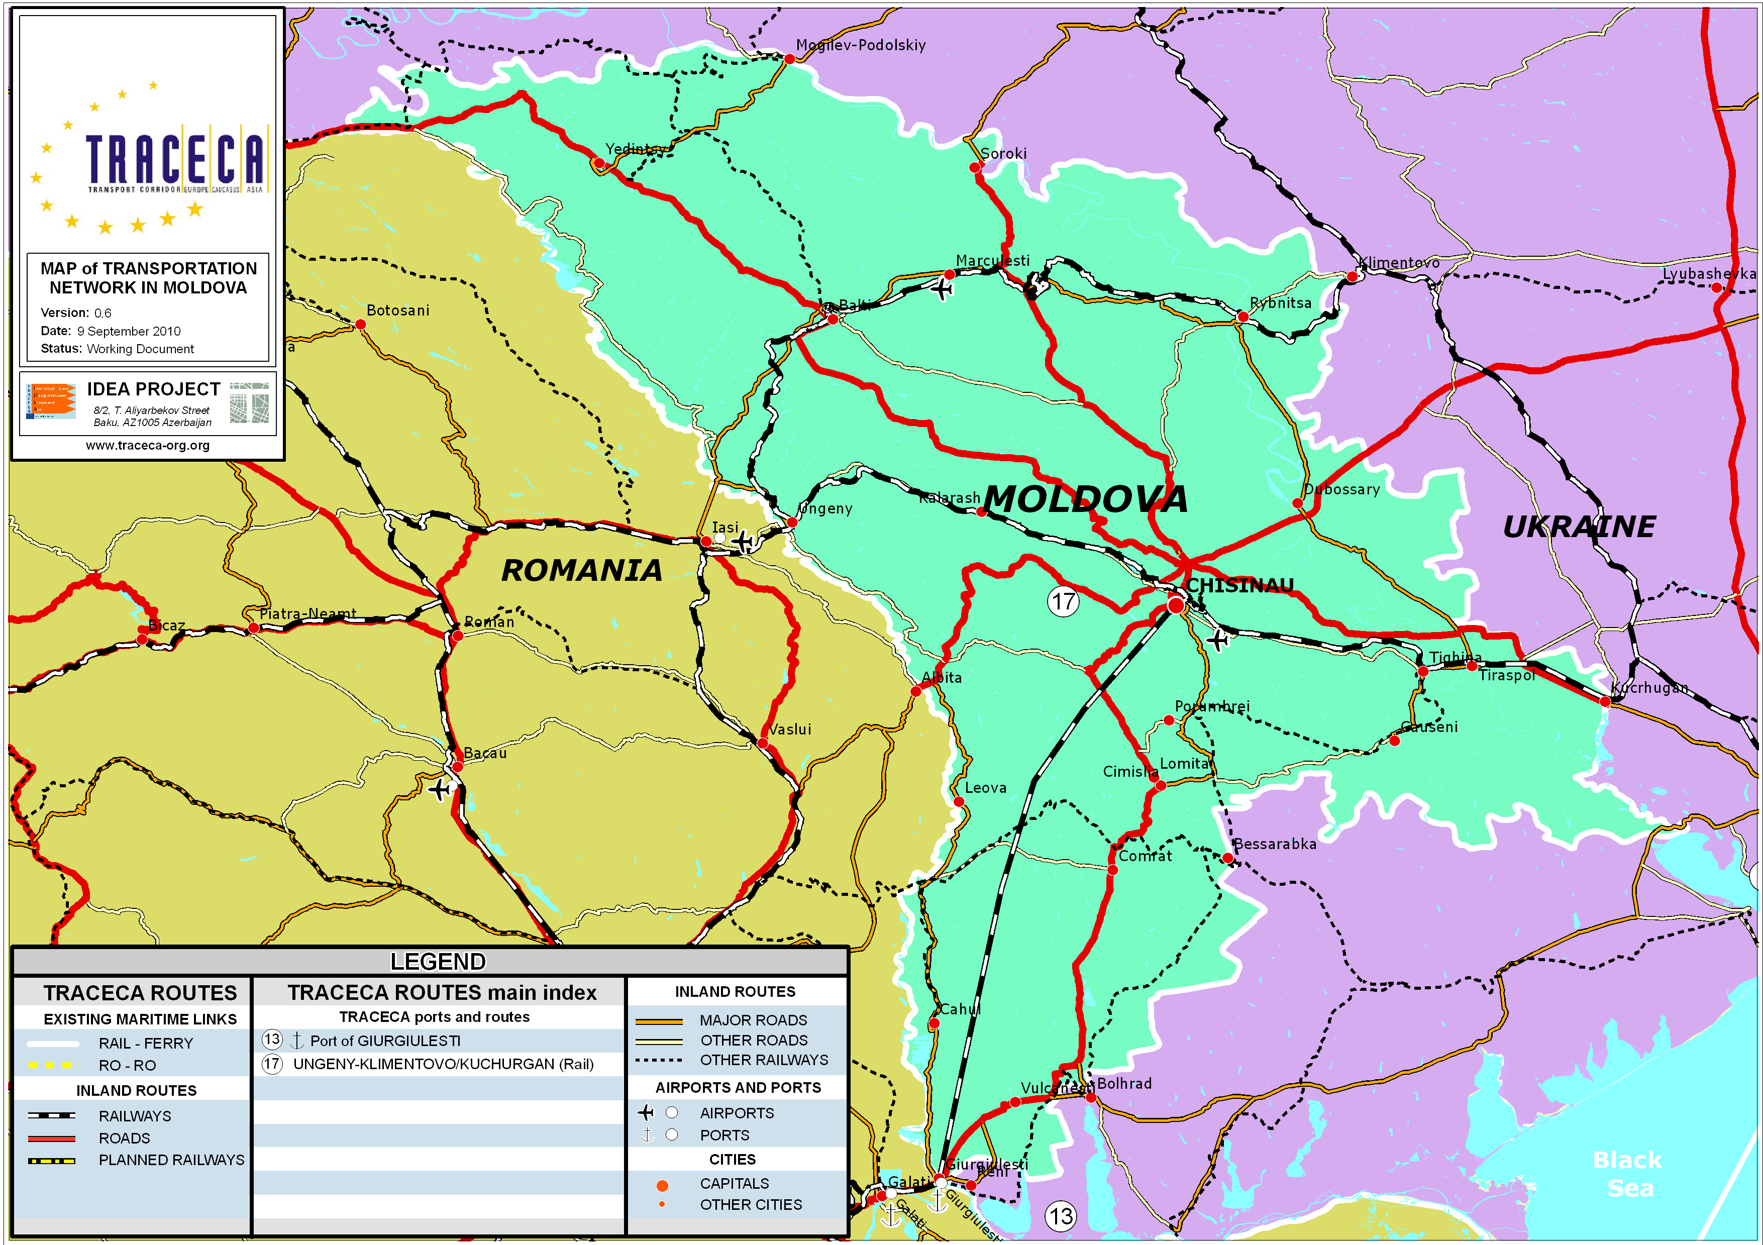
Connection of the national network to the MULTIMODAL CORRIDOR EUROPE - CAUCASUS - ASIA (TRACECA) – (Conference in Brussels, 1993)
International importance of the M14 Criva – Balti–Chisinau–Tiraspol–Ukrainian border road

Slide 4
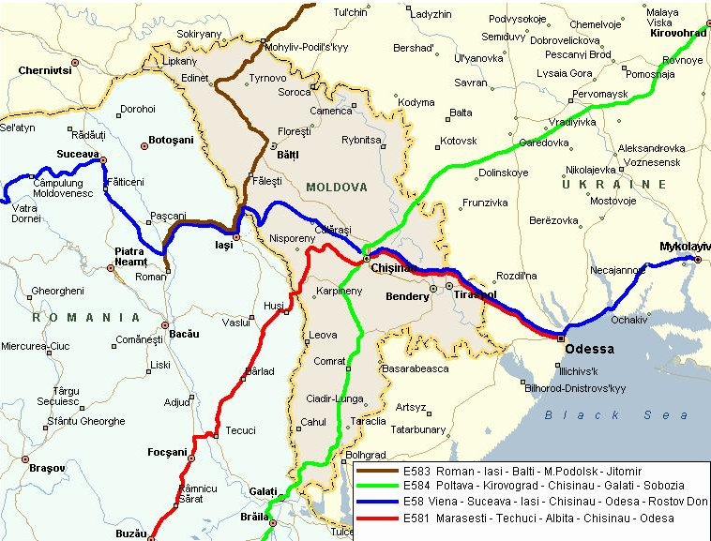
Infrastructure development and improving the connection with European Transportation Networks
International importance of the M14 Criva – Balti–Chisinau–Tiraspol–Ukrainian border road
Euro-Roads (AGR)
European Agreement on the great international roads (AGR) Republic of Moldova Law nr. 17-XVI, 10.02.2006

Slide 5
Designed sectors for rehabilitation of M14 road
Length km | Sector, km | Cost, mil. Euro | Number of lanes
39 | 591-630 | 31,9 | 2
Length, km | Sector, km | Cost, mil. Euro | Number of lanes
32 | 630-662 | 23,5 | 2
Length, km | Sector, km | Cost, mil. Euro | Number of lanes
33 | 662-695 | 42,4 | 4
Length, km | Sector, km | Cost, mil. Euro | Number of lanes
31 | 695-724 | 35,8 | 4

Slide 6
Project technical specification
The feasibility study was elaborated by NATHAN associates incorporate;
According with feasibility study Internal Rate of Return (IRR) is 15.6 % and the project is feasible;
Project documentation was elaborated by KOCKS ingenieure and Universinj SRL in 2012;
For project implementation is not necessary land allocation;
The project is included in the Transport and Logistics Strategy for 2013-2022 as a priority project;
Rehabilitation of the M14 road is the priority project for Eastern Partnership.

Slide 7
Estimated traffic distribution 2012-2032 on M14 Criva-Balti sector
Traffic distribution data is taken from Appendix I-A. Automatic Traffic Counts for 2009-2011 and Appendix I-B. Manual Traffic Counts for 2011 from Technical Report – road sector donned by and based on macroscopic computer model.

Slide 8
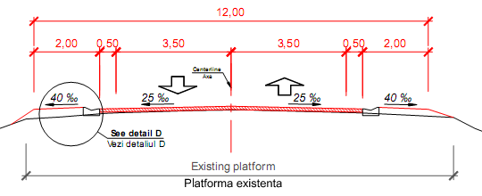
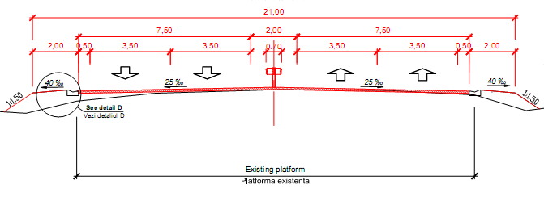
Typical cross-sections

Slide 9
Thank You for Attention
Ministry of Transport and Road Infrastructure
Republic of Moldova
email: www.mtid.gov.md

