Slide 1
State Road Agency of Ukraine
Priority Infrastructure Road Projects in Ukraine
Brussels, 2017

Slide 2
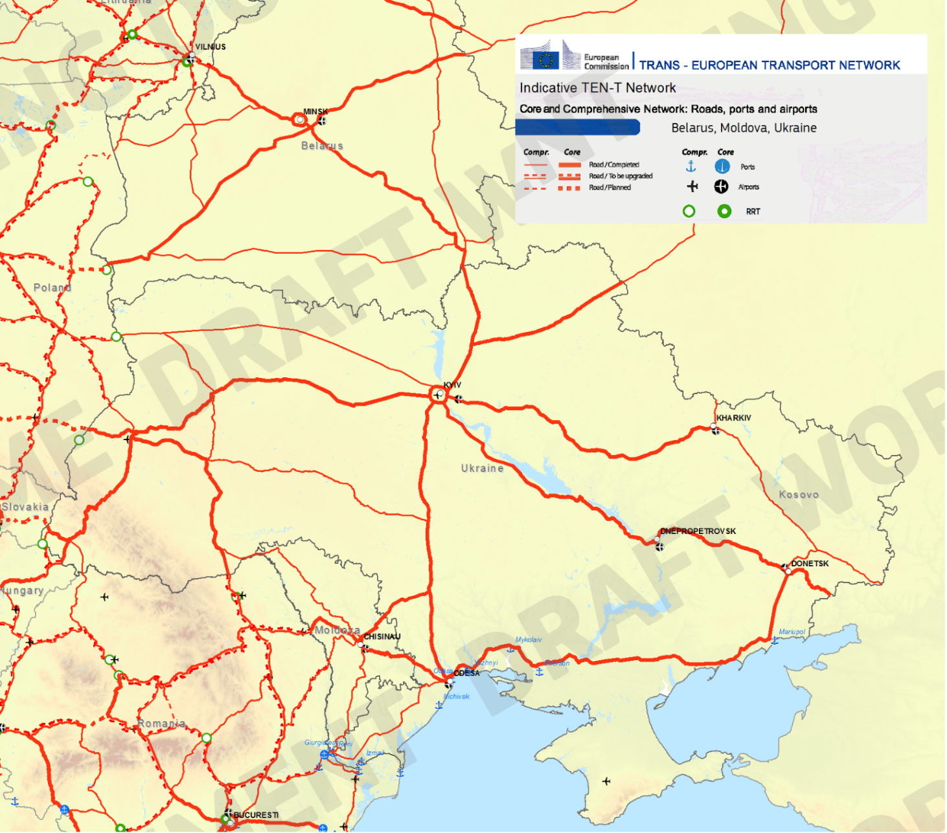
TEN-T Network
2
1
3
5
4
6
2
4
2
8
5
7
4
3
1
3
1
6

Slide 3
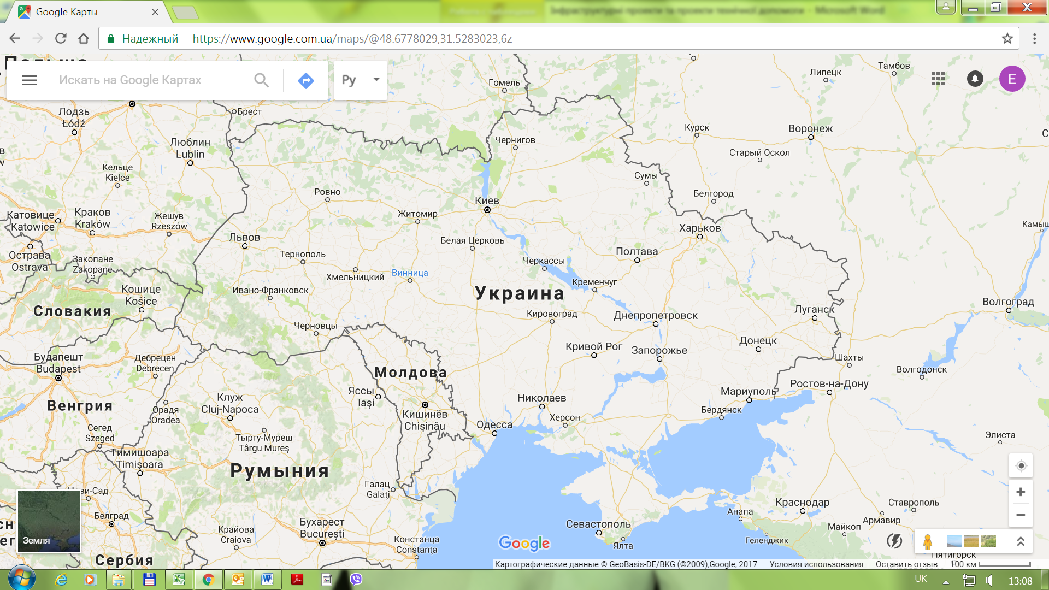
Ukraine map
2
1
8
4
6
5
7
3

Slide 4
Priority infrastructure road projects for IFS’ financing
(I stage of prioritization) marked with red
1. Construction and reconstruction works: road route Lviv – Uman – Odesa
2. Construction of Lviv by-pass
3. Construction, reconstruction and capital repair of M-01 Kyiv – Chernihiv – Novi Yarylovychi Road (Kipti – Belorussian border)
4. M-05 Kyiv – Odesa Road (section Bila Tserkva - Uman)

Slide 5
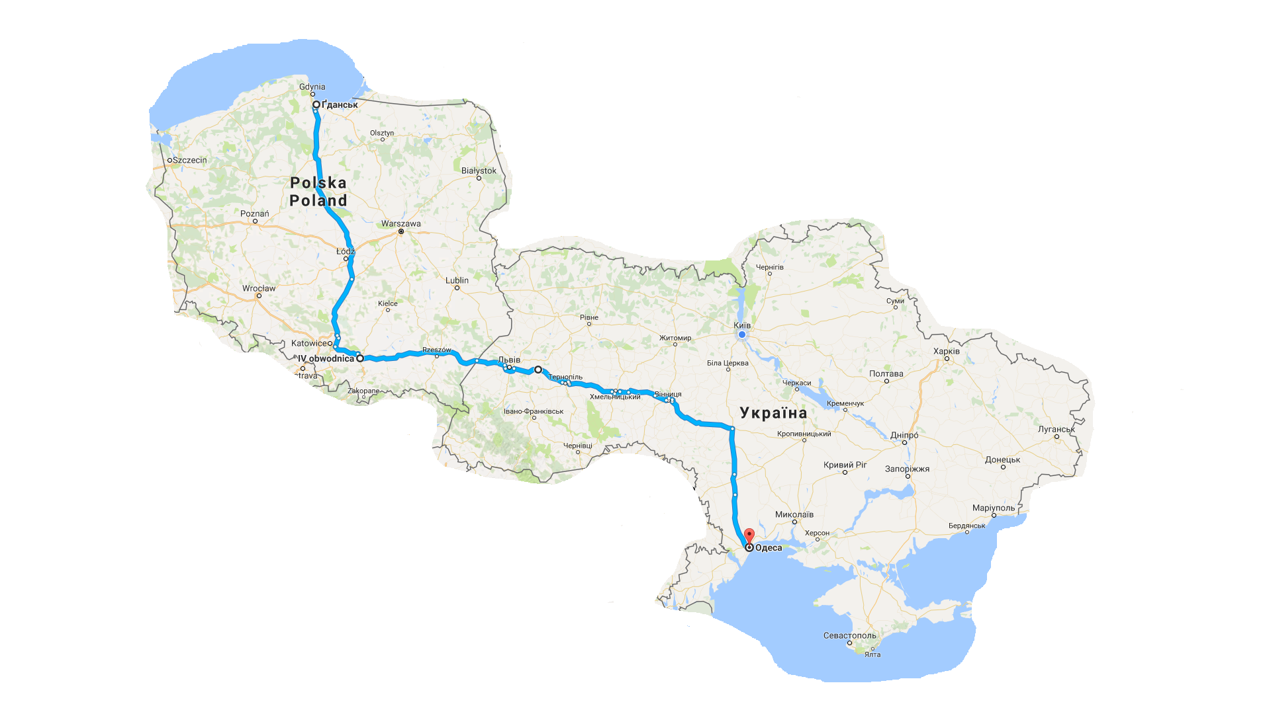
Road route Lviv – Uman – Odesa
Total project cost: 1 889.3 mln. EURO (54 792,3 mln. UAH)., including road sections:
М-10 Lviv – Krakovets Road: 6 865,2 mln. UAH., design and estimate documentation need to be amended.
М-06 Kyiv – Chop Road (Lviv by-pass): 1 200 mln. UAH., design and estimate documentation have to be developed.
Н-02 Lviv – Ternopil Road: 9 720 mln. UAH., design and estimate documentation have to be developed.
М-12 Stryi – Ternopil – Kirovograd – Znamianka Road (Ternopil - Uman): 27 900 mln. UAH., feasibility study is under preparation.
М-05 Kyiv – Odesa Road (Uman – Odesa section) : 9 100 mln. UAH., design and estimate documentation for all sections is under preparation.
Н-02 Lviv – Ternopil Road
Reconstruction to I category: 91 km.
Cost: 255.9 mln.EURO (6,55 bln. UAH).
Construction of by-passes and transport interchanges: 21,5 km.
Cost: 109.3 mln.EURO (3,17 bln. UAH).
E 75
М-05 Kyiv – Odesa (Uman – Odesa) Road
Capital repair: 267 km.
Cost: 313.8 mln.EURO (9,1 bln. UAH).
E 40
М-10 Lviv – Krakovets Road
Capital repair: 2,8 km.
Cost: 3.3 mln.EURO (95,2 mln. UAH).
Reconstruction to I category: 74 km.
Cost: 182.8 mln.EURO (5,3 bln. UAH).
Construction of by-passes and transport interchanges: 11 km.
Cost: 1,47 млрд. грн.
E 50
E 95
М-06 Kyiv – Chop Road
(Lviv by-pass)
Reconstruction to I category: 15 km.
Cost: 37.3 mln.EURO (1,08 bln. UAH)
Construction of transport interchange: 1 km.
Cost: 4.1 mln.EURO (120 mln. UAH).
М-12 Stryi – Ternopil – Kirovograd – Znamianka Road (Ternopil - Uman)
Capital repair: 68 km.
Cost: 79 mln.EURO (2,3 bln. UAH).
Reconstruction to I category: 324 км.
Cost: 803.4 mln.EURO (23,3 bln. UAH).
Construction of by-passes and transport interchanges: 15 km.
Cost: 79 mln.EURO (2,3 bln. UAH).

Slide 6
Construction of Lviv by-pass
Total length: 24 km.
Cost: 122.5 mln. EURO (3 553 mln. UAH).
Type of works: construction.
Design and estimate documentation: have to be developed.
Polish Border
Kyiv
LVIV
Ivano-Frankivsk
Hungarian Border

Slide 7
M-01 Kyiv – Chernihiv – Novi Yarylovychi Road (section Kipti – Belorussian border)
Total length: 119,6 km.
Cost: 348.5 mln. EURO.
Type of works: construction and reconstruction.
Design and estimate documentation: is under development.
Belorussian Border
CHERNIHIV
Kyiv

Slide 8
M-05 Kyiv – Odesa Road (section Bila Tserkva - Uman)
Total length: 187 km.
Cost: 374.9 mln. EURO.
Type of works: capital repair.
Design and estimate documentation: is under development.
BILA TSERKVA
Kyiv
UMAN
Odessa

Slide 9
Priority infrastructure road projects for IFS’ financing (II stage of prioritization) marked with green
1. Reconstruction of R-52 Dnipropetrovsk – Tsarytchanka – Kobeliaky – Reshetylivka Road;
2. Construction of Boryspil by-pass
3. N-11 Dnipropetrovsk – Mykholaiv Road (section Dnipropotrovsk – Kryvyi Rig)
4. M-06 Kyiv- Chop Road (section Uzhgorod - Mykachevo)
5. M-19 Domanovo – Kovel – Chernivtsi – Terebleche and N-22 Ustylug – Lutsk – Rivne (section Kovel - Rivne)
6. M-27 Odesa – Ilichivsk

Slide 10
Location of II stage of prioritization projects
M-19 Domanovo – Kovel – Chernivtsi – Terebleche and N-22 Ustylug – Lutsk – Rivne
cost: 120.7 mln.EURO;
length:140 km;
type of works: capital repair;
design and estimate documentation: have to be developed
Boryspil by-pass
cost: 41.4 mln.EURO;
length: 5 km;
type of works: construction;
design and estimate documentation: have to be developed
R-52 Dnipropetrovsk – Tsarytchanka – Kobeliaky – Reshetylivka cost: 354.5 mln.EURO;
length: 137 km;
type of works: reconstruction and construction;
design and estimate documentation: is under development
M-06 Kyiv- Chop Road
cost: 55.2 mln.EURO;
length: 30 km;
type of works: capital repair and reconstruction;
design and estimate documentation: have to be developed
N-11 Dnipropetrovsk – Mykholaiv Road
cost: 720 mln.EURO;
length: 129 km;
type of works: capital repair and reconstruction;
design and estimate documentation: have to be developed
M-27 Odesa – Ilichivsk
cost: 29 mln.EURO;
length: 14 km;
type of works: reconstruction;
design and estimate documentation: have to be developed

Slide 11
Priority infrastructure road projects for IFS’ financing (III stage of prioritization) or other source of funds (TA) marked with yellow spots
Reconstruction to category-1 4 lane international road M-07 / E373 Kyiv - Kovel – Yagodyn, cost: 63.06 mln. EURO;
Construction of an overpass at km 522 + 250 international road M-06 / E40 Kyiv – Chop, Lviv region, cost: 3.5 mln. EURO;
Construction of overpasses across railway tracks at km 618 + 500 and 618 + 900 international highway M-06 / E50 Kyiv - Chop, Lviv region, cost: 5.8 mln. EURO;
Construction of M06/M19 multi level road interchange, Rivne region, cost: 10.3 mln. EURO;
Construction of M06/M12 road interchange overpass at km 609+700 at the intersection of international highways M-06 / E40 Kyiv – Chop and M-12 / E50 Stryi - Ternopil - Kirovograd - Znamenka, Lviv region, cost: 9.5 mln. EURO;
Construction of overpass across railway at km 213 + 950 international road M-19 / E85 Domanovo - Kovel - Chernivtsi - Terebleche in Dubno, Rivne region, cost: 4.95 mln. EURO;
Construction of overpass across railway at km 64+339 road of national importance N-02 Lviv - Ternopil, Lviv region, cost: 4.95 mln. EURO.

Slide 12
Location of IІI stage of prioritization projects
2
1
8
4
6
5
7
3

Slide 13
THANK YOU FOR YOUR
ATTENTION
ANNA YURCHENKO
Deputy Director
Department for Strategy and Coordination Work
+38 044 287 74 08
loans@ukravtodor.gov.ua
State Road Agency of Ukraine

