Slide 1
Reconstruction of the section M-10 road
The section of the road M-10 the border of the Russian Federation (Selishche)-Gomel-Kobrin, km 109.9-km 195.15, length 85.25 km is located in the Gomel region of the Republic of Belarus and provides communication between the cities Rechitsa and Kalinkovichi.

Slide 2
Main technical and economic indicators
Length of road section, km | 85,25
 | Main existing technical and economic parameters of the road section: | The main required technical and economic parameters of the road section:
Road category Number of lanes Intensity of movement, Cars per day Load on the axle of a biaxial Of the car, tons Speed mode for Cars Trucks | II 2 3 800 – 5 100 | I 4 6 900 – 9 200 11,5 120 km/h 100 km/h

Slide 3
Project structure
Investment size | 200 mln EUR
Proposed PPP model | Payments from the republican budget
Term of the project: Project start date Reconstruction period | 2018 2018 - 2020
Estimated term of the agreement | 22 years
Stages of the project implementation, as well as a possible version of the distribution of risks for the project | Will be determined in the preparation of feasibility studies of investments approved in accordance with the established procedure

Slide 4
The obligations of a private partner
Involvement of investment in the project in the amount established by the PPP agreement;
Reconstruction of the section of the M-10 highway (km 109.9 - km 195.15);
Commissioning of the facility and its further operation;
Maintenance, current and major repairs.

Slide 5
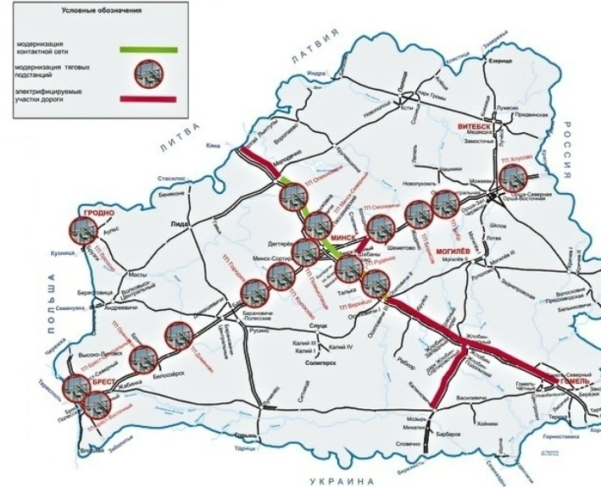
RAIL PROJECTS
Modernization of the contact network at Zhdanovichi-Molodechno section of Minsk Region - estimated cost is 36,5 mln.$.
The development of the project 2017-2018, the beginning of construction - 2018, the duration of construction - 18 months
Electrification of Gomel - Zhlobin - Osipovichi and Zhlobin - Kalinkovichi railway tracks. Third stage. Zhlobin – Kalinkovichi railway track.
Estimated cost is
55 mln.$.
The beginning of construction - 2018, duration of construction - 24 months.
Source of funding is not defined

Slide 6
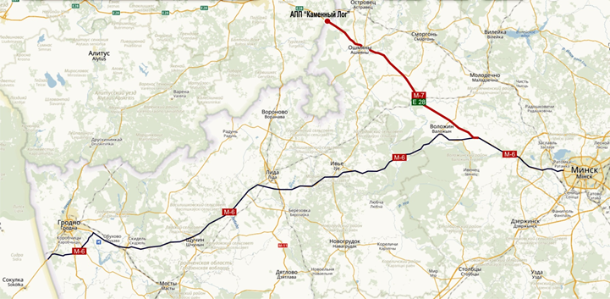
Reconstruction of the M-7 / E28 road Minsk-Oshmyany-border of the Republic of Lithuania (Kamenny Log), km 57.7-km 146.8
The goal of the project is the reconstruction of the road section between Vilnius and Minsk M-7/E28 Minsk - Oshmyany - border of the Republic of Lithuania (Kamenny Log) with length 89 kilometers: 1/3 of the length can be reconstructed for the parameters of the I category, by 2/3 it is supposed to strengthen the construction of pavement for loading on the axis of 11.5 tons by parameters of the road of the II category. The estimated project cost is 80 mln EUR. Source of funding - IFIs, national co-financing

Slide 11
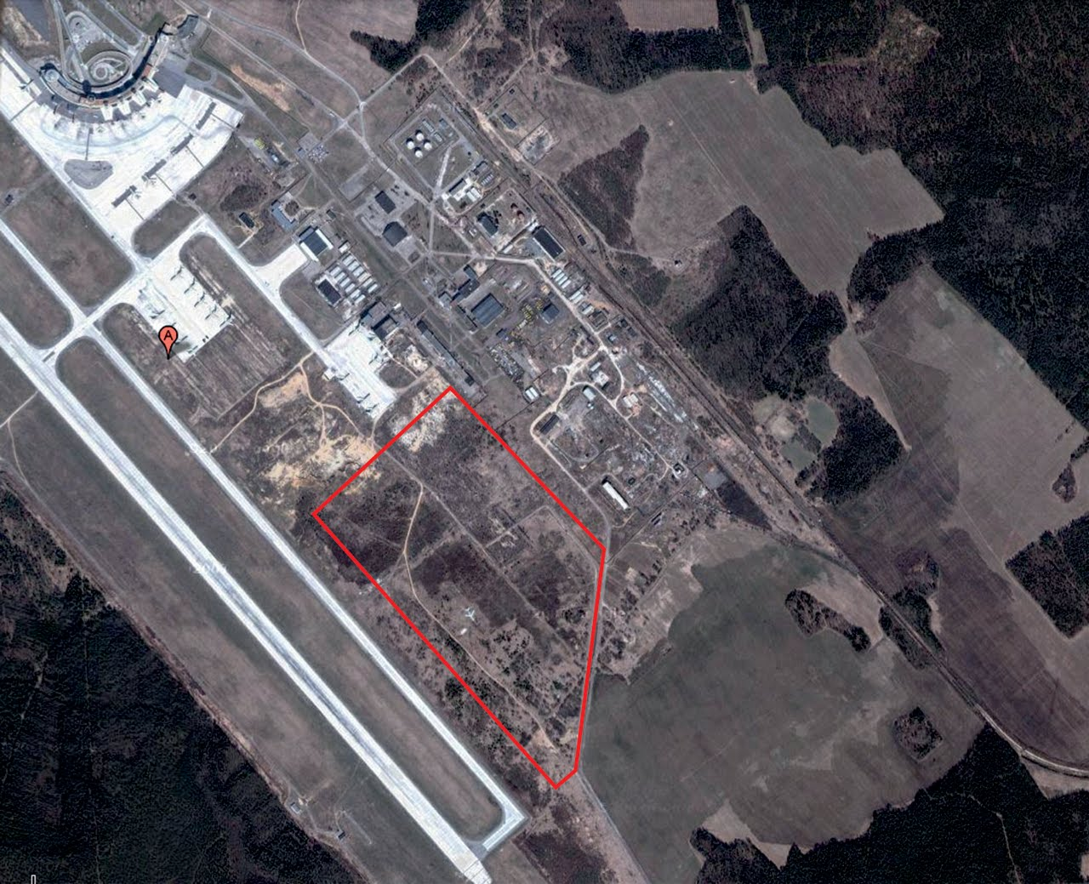
Construction of aircraft repair plant in the "National Airport "Minsk"

Slide 12
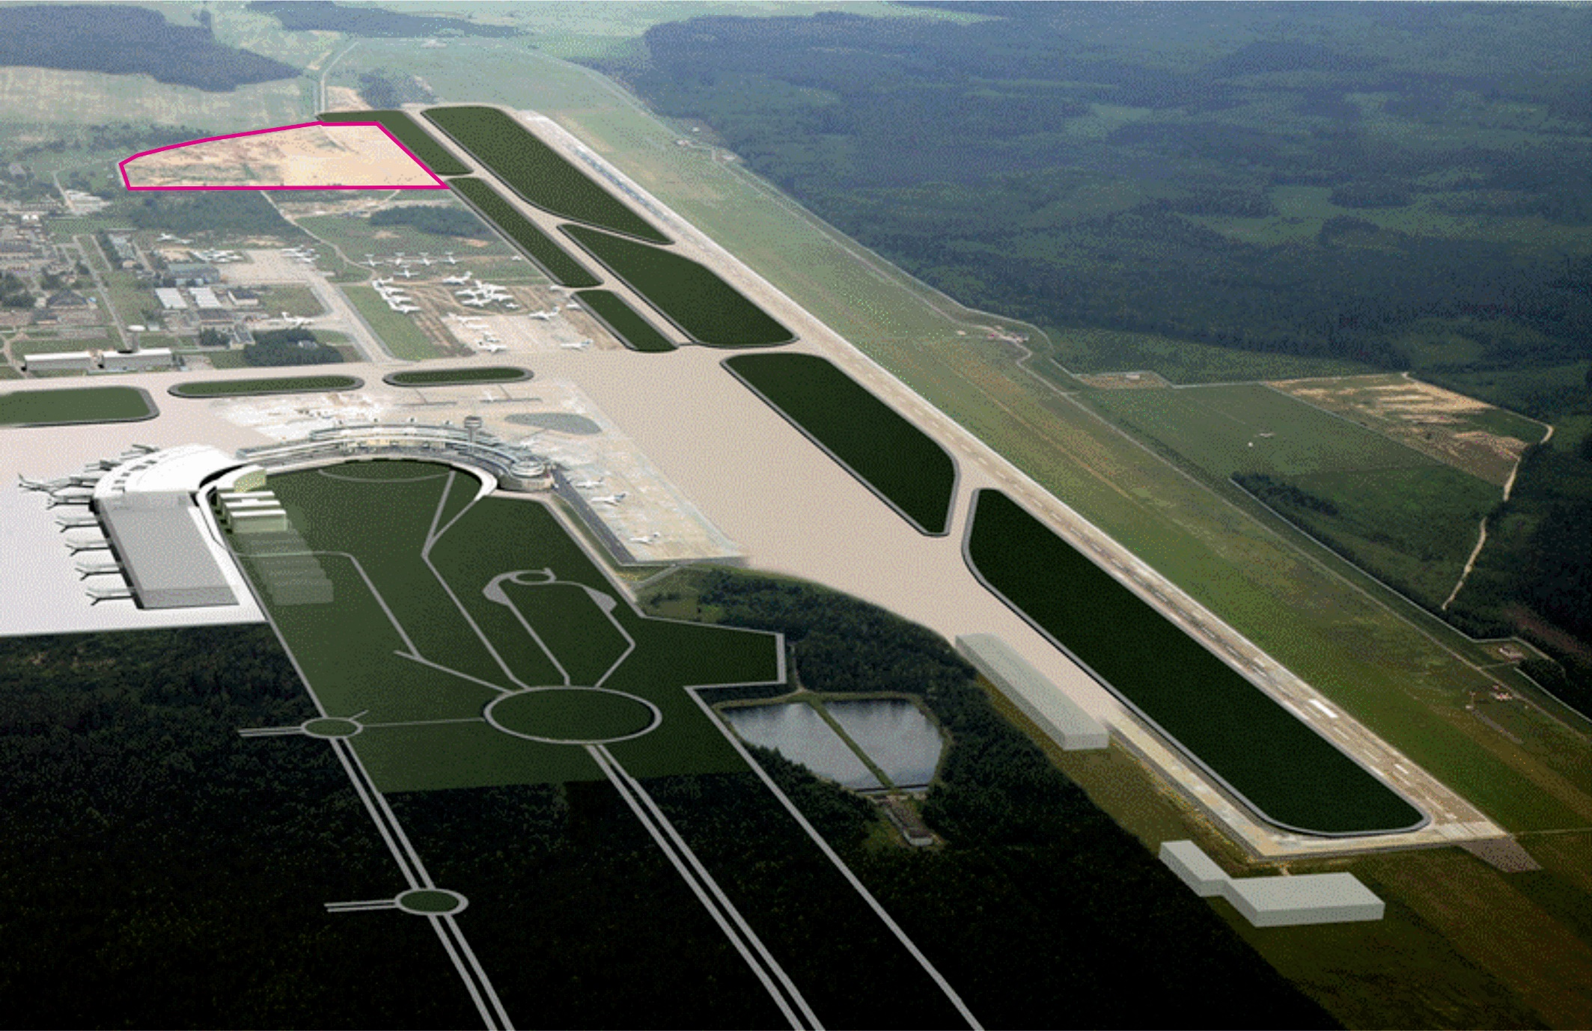
The area allocated for the construction of aircraft repair plant in the National Airport "Minsk“ occupies 28 hectares (Project visualization)

Slide 13
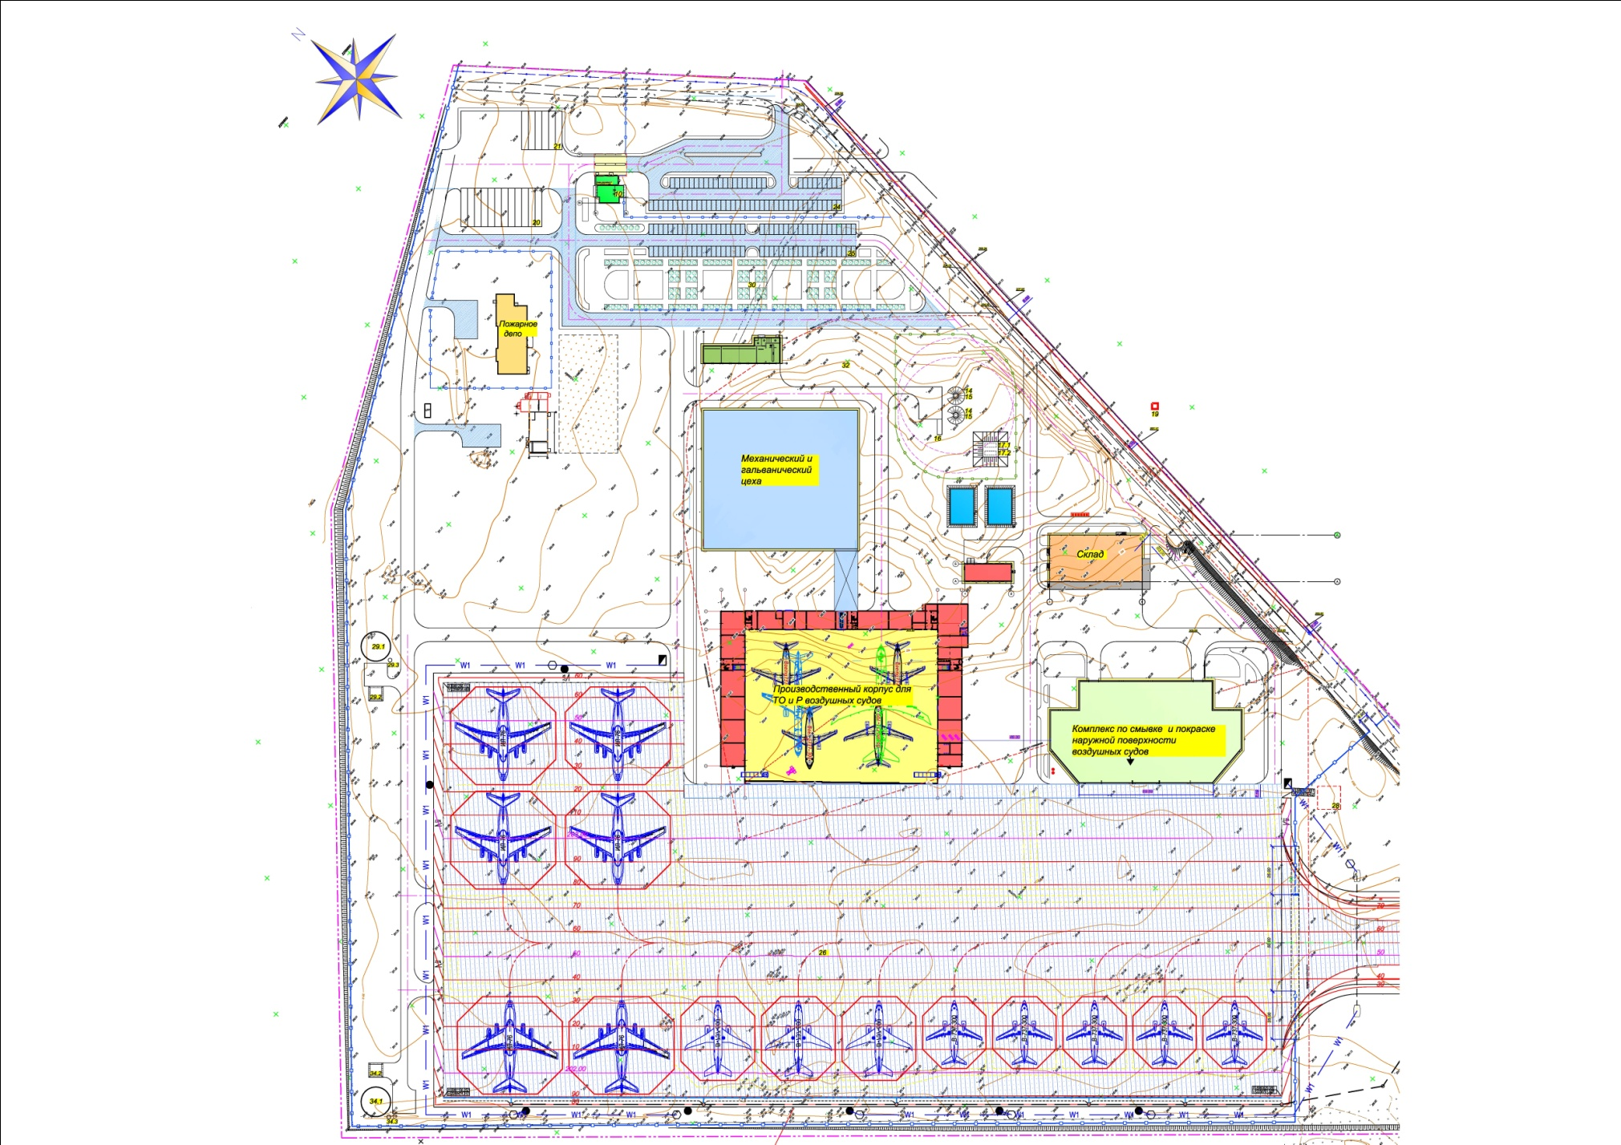
General layout plan of the plant
1st stage of construction:
concrete pavement, taxiways, platform, etc;
2nd stage of construction:
- 1st starting complex: storm drainage, temporary power supply of the platform, layout of the whole territory;
- 2nd starting complex: MRO hangar with additional buildings;
- 3rd starting complex: infrastructure, gas boiler, gas networks, communication networks;
4th starting complex: mechanic and galvanic hangar;
- 5th starting complex: remove-and-paint hangar.
3rd stage of construction:
water supply, external networks, treatment facilities, 10 kV cable line from substation "Airport", a protective shelter for 250 people, video surveillance, fire station.

Slide 14
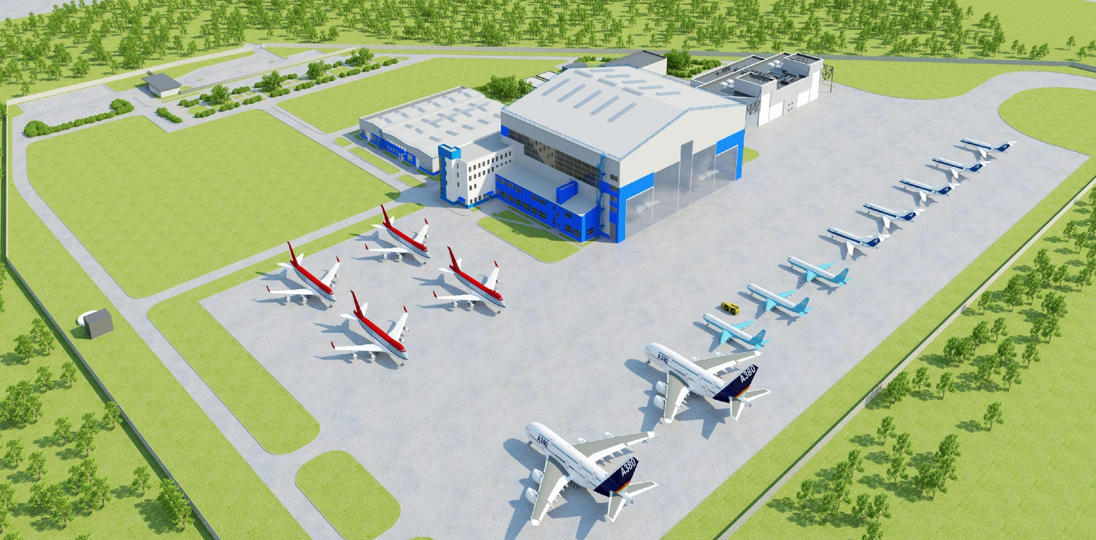
General layout plan of the plant

Slide 15
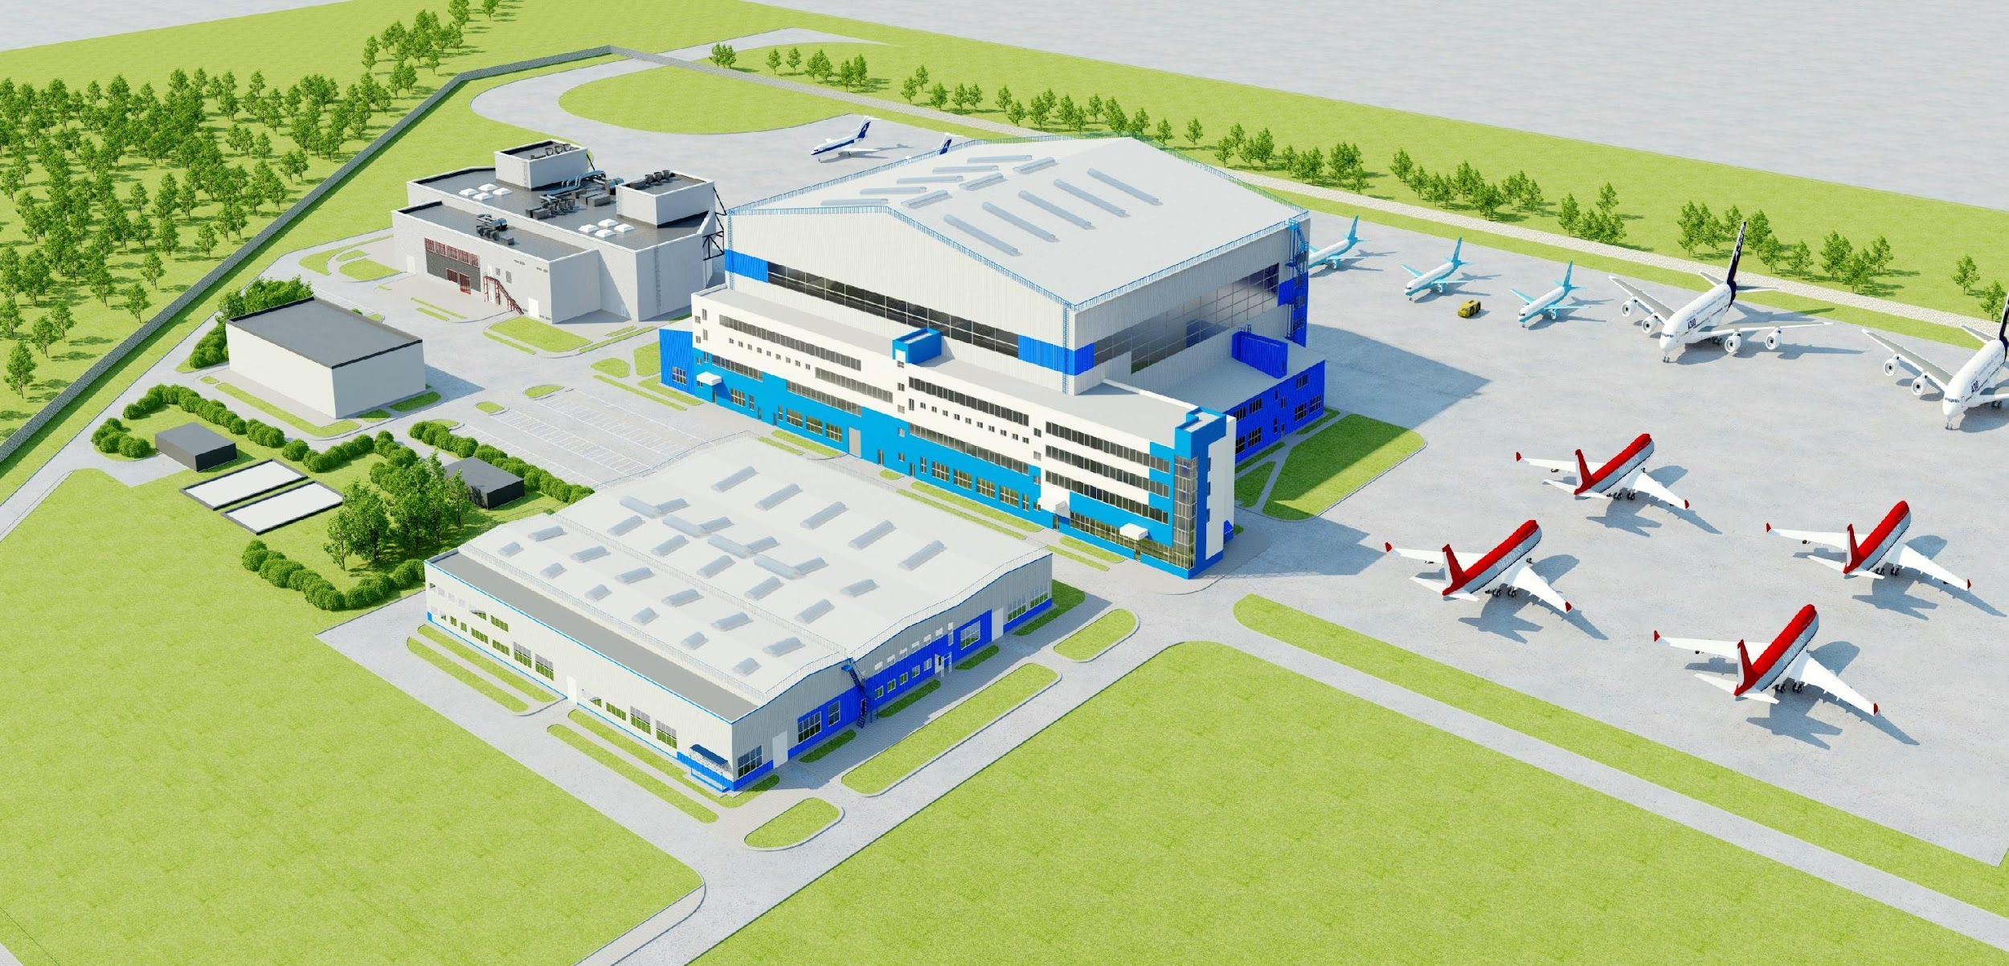
General layout plan of the plant

Slide 16
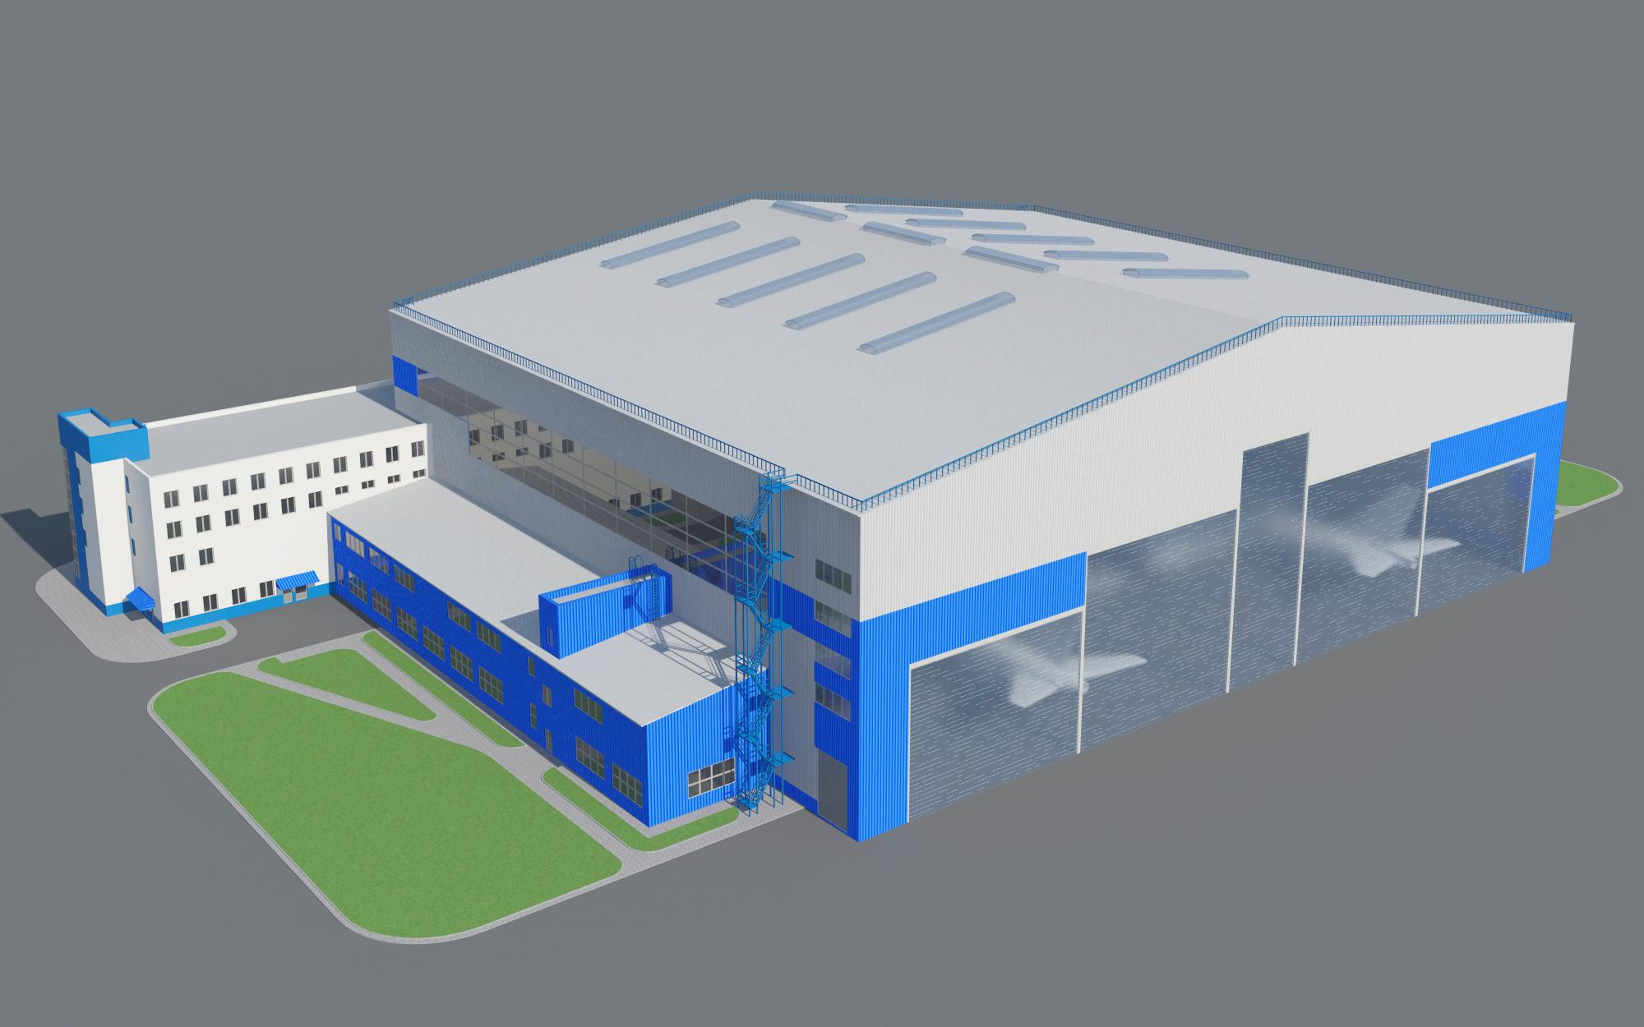
Maintenance and repair hangar (view from West)
The project of hangars is designed by State Enterprise "Belzheldorproject“ Institute with the participation of specialists from Lufthansa Consulting Group.
The hangar is designed to receive aircraft of various passenger capacity manufactured by the world aviation industry except the Airbus A380.
The dimensions of the hangar is 99,6x84,4 m The height of the hangar is 25 m The area of the hangar is 8467 m² The area of departments is 9812 m²

Slide 17
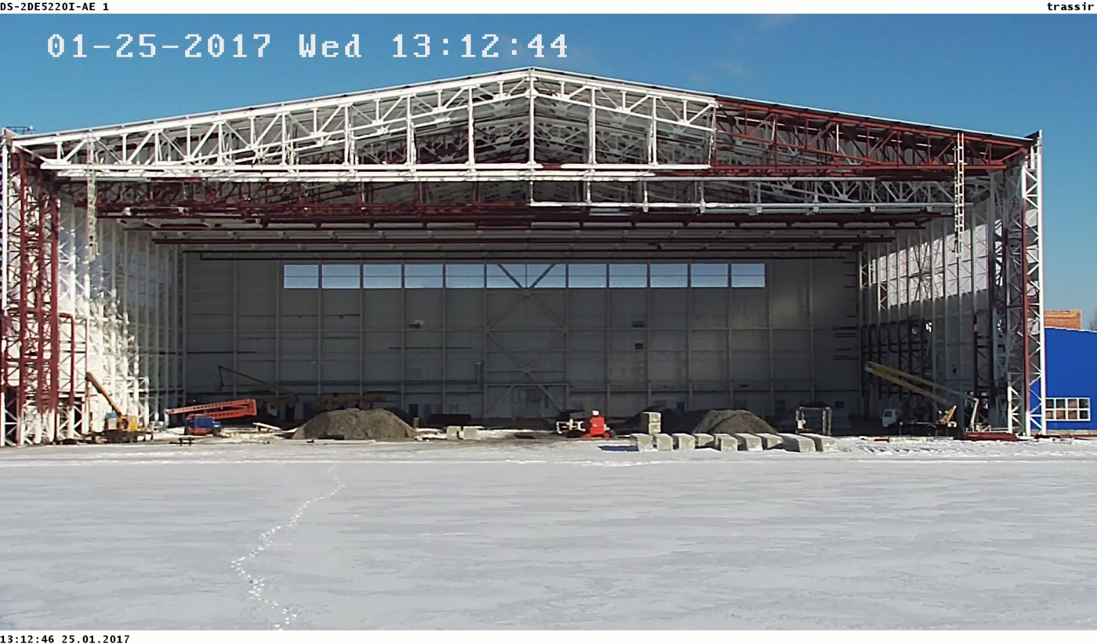
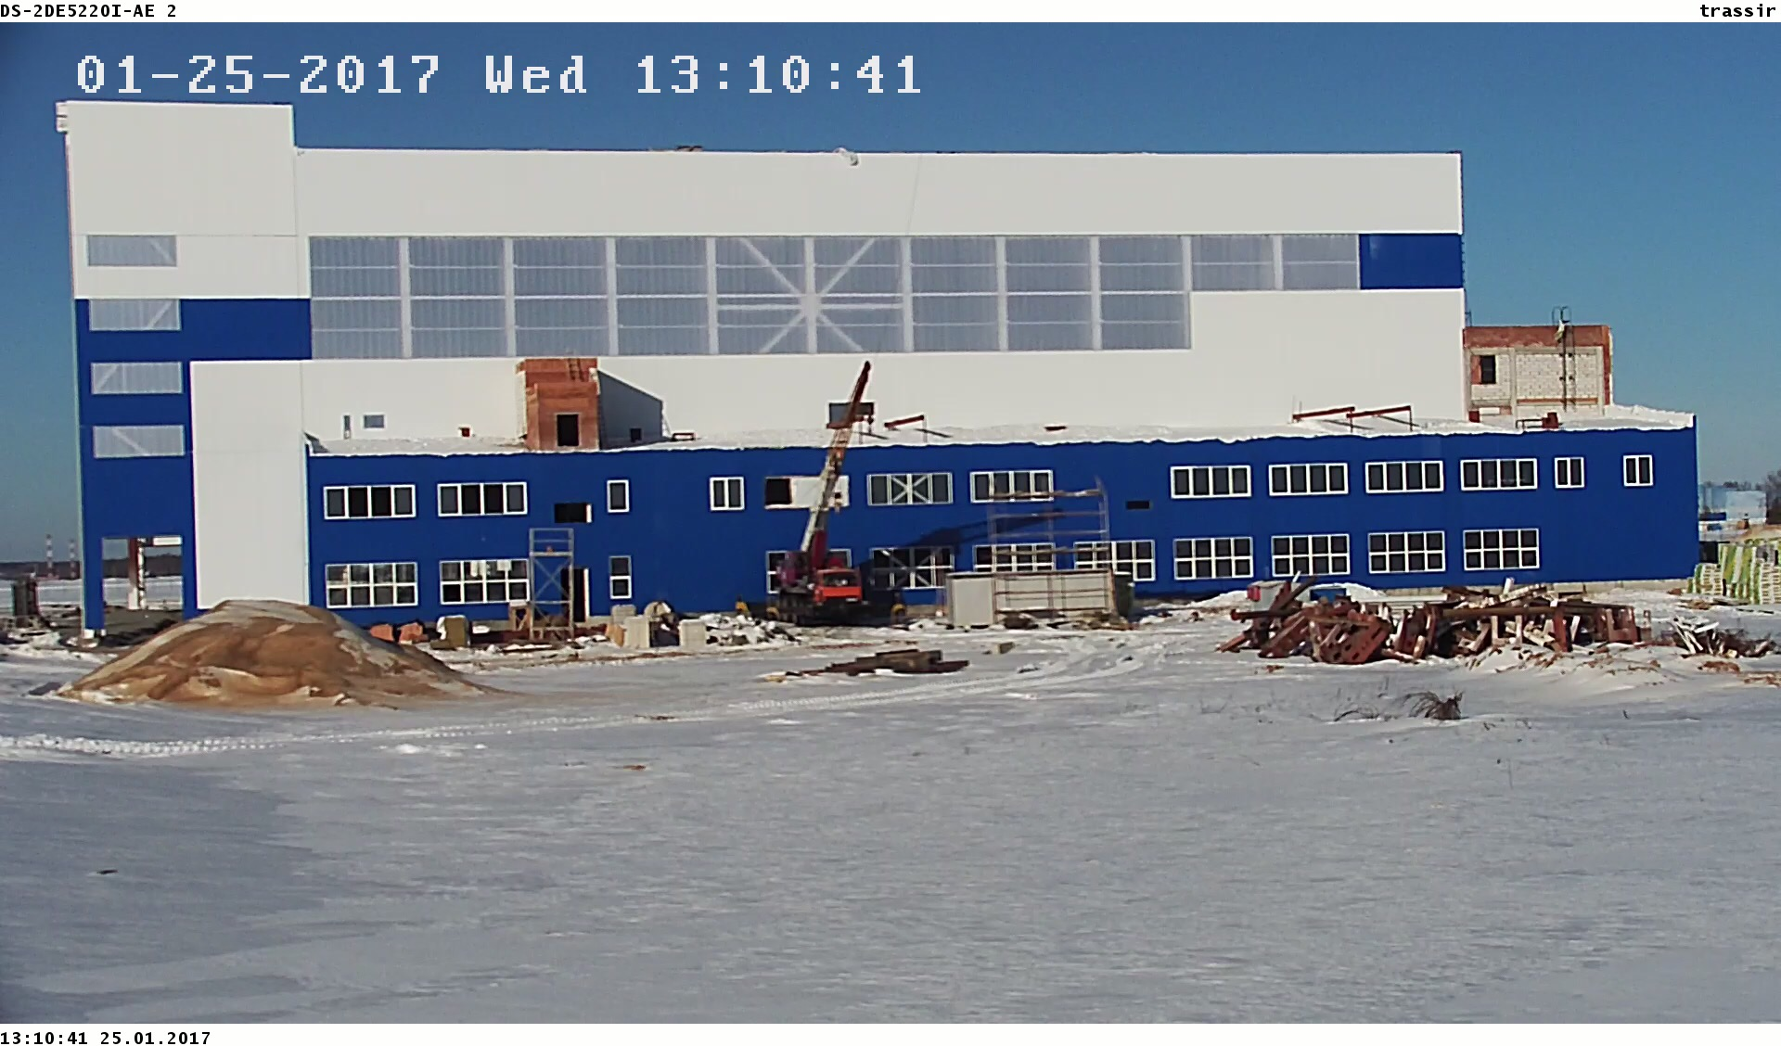
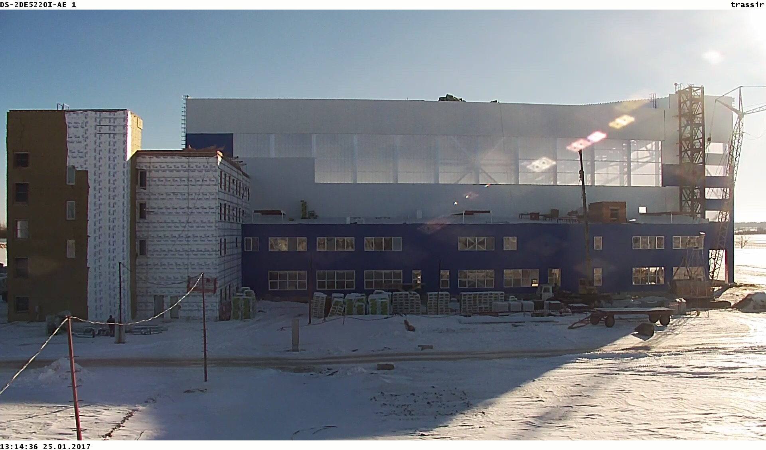
Maintenance and repair hangar

Slide 18
Remove-and-paint hangar
Dimensions 90х54 m
Height 16 m
Area 5467 m²
When planning the construction of a hangar applied the principle of aerodynamics, which minimizes the cost of thermal energy. The hangar is designed to accommodate narrow-body aircraft.

Slide 19
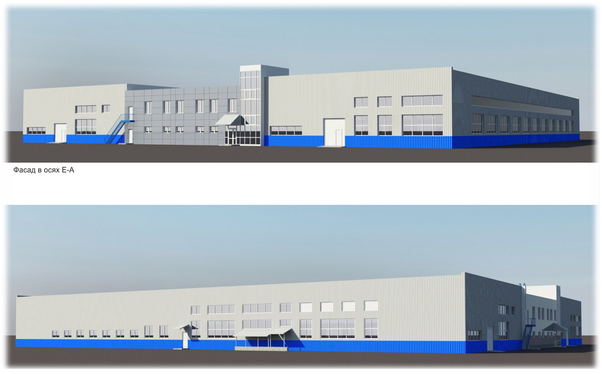
Mechanic and galvanic hangar

